Slide 1
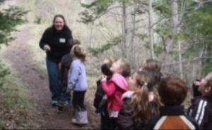

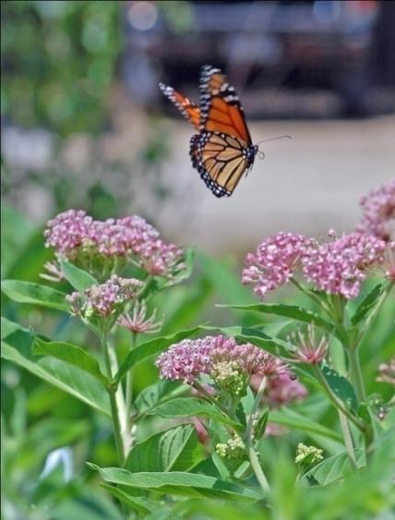
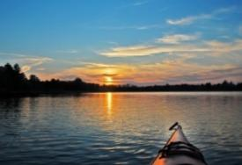
    2020 Spring Partner Meeting
Protecting, enhancing, and promoting northwest Michigan's natural communities through terrestrial invasive plant management and outreach.
    HabitatMatters.org

Slide 2
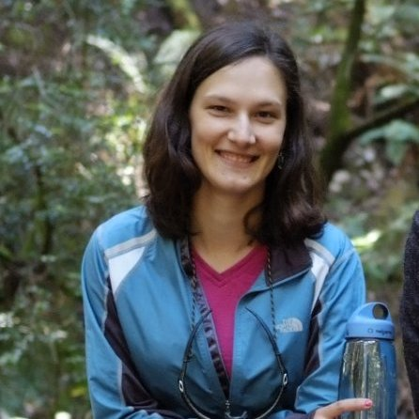
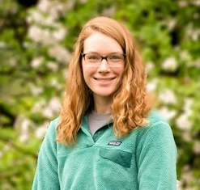
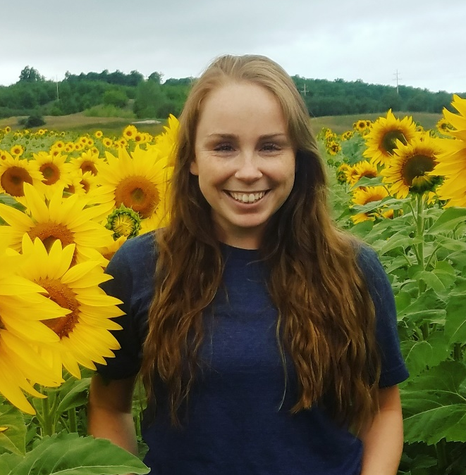
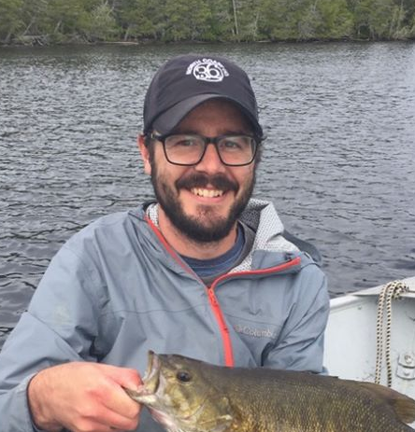
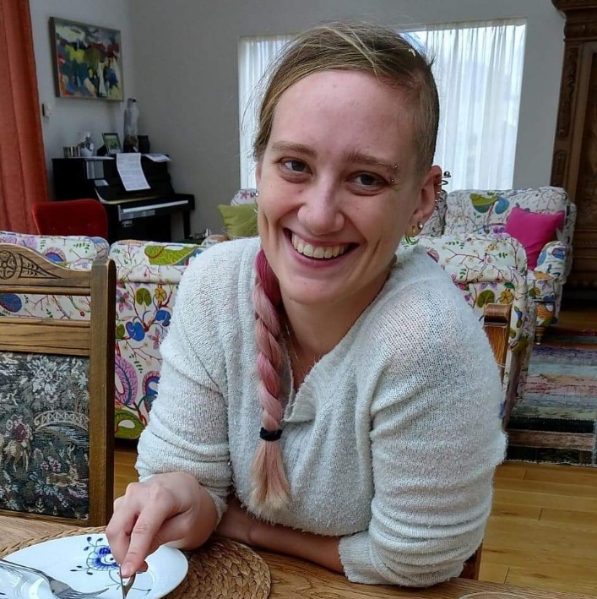
ISN Staff
Katie Grzesiak, Coordinator
Emily Cook, Outreach Specialist
Shelly Stusick, GBB Specialist
Fields Ratliff, Habitat Mgmt Specialist
Audrey Menninga, Inv. Spp. Specialist

Slide 3











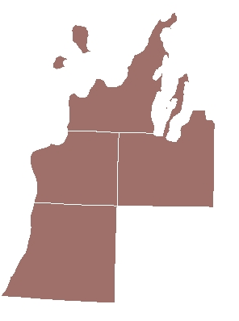
Funding provided by:
Michigan Invasive Species Grant Program
Great Lakes Restoration Initiative
Major Partners
Garfield Township
City of Frankfort
Benzie Long Lake Association
Portage Lake Watershed Forever
Friends of Betsie Bay
The Nature Conservancy
Sleeping Bear Dunes National Lakeshore
Grand Traverse Band of Ottawa and Chippewa Indians
Grand Traverse Audubon Club
Little Traverse Bay Band of Odawa Indians
Notes:
ISN’s major partners include the conservation districts of Grand Traverse, Leelanau, Benzie and Manistee Counties, as well as a number of other concerned organizations and municipalities.

Slide 4
Mission
Protecting, enhancing, and promoting northwest Michigan’s natural communities through terrestrial invasive plant management and outreach.
Serving Benzie, Grand Traverse, Leelanau, and Manistee counties

Slide 5
ISN Goals
Raise awareness of high-priority invasive species in the region through education in order to cultivate long-term stewardship of our natural areas
Prevent introduction and spread of terrestrial invasive plants through outreach and collaboration with government officials and garden professionals
Survey region for high-priority terrestrial invasive plants to aid in effective prioritization and treatment strategies
Facilitate and assist with treatment of high-priority species on public and private land based on survey maps and prioritization strategies

Slide 6
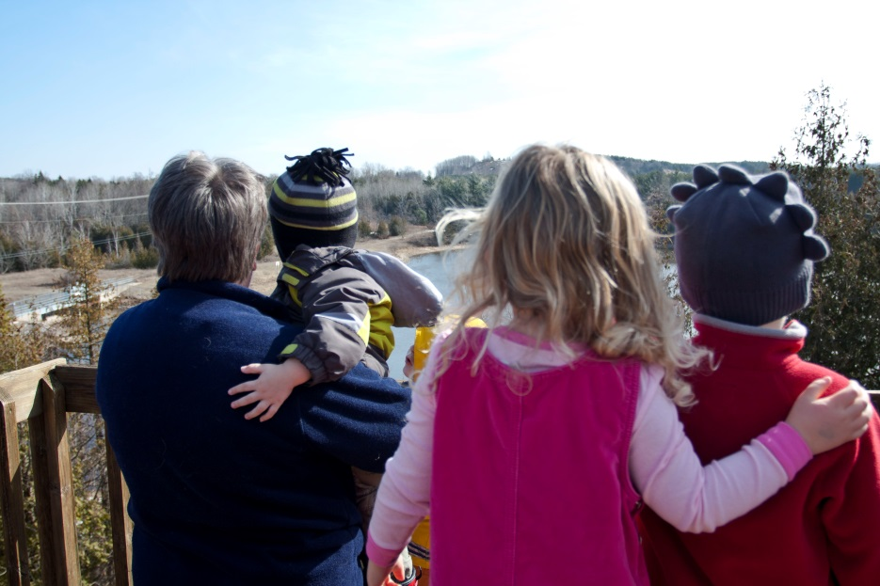
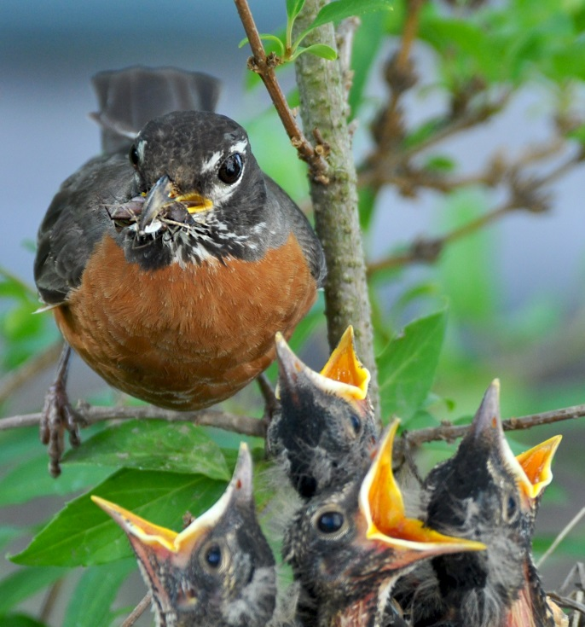
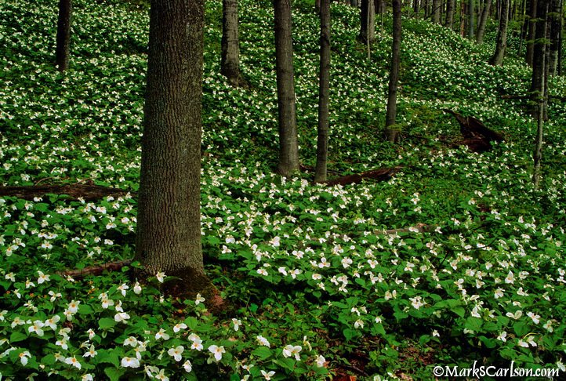
Habitat Matters
For People
For Wildlife
For Northwest Michigan
Notes:
Why we do what we do
For people: recreation, enjoyment
Wildlife: habitat! Need it to live, and we use lots of them (pollinators, game spp, birdwatchers)
NW MI: tourism & logging industries etc.

Slide 7
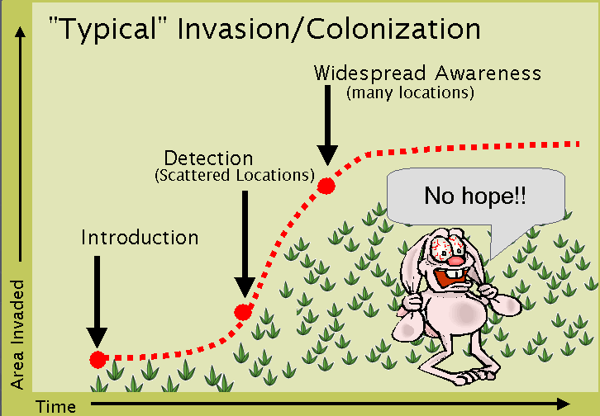
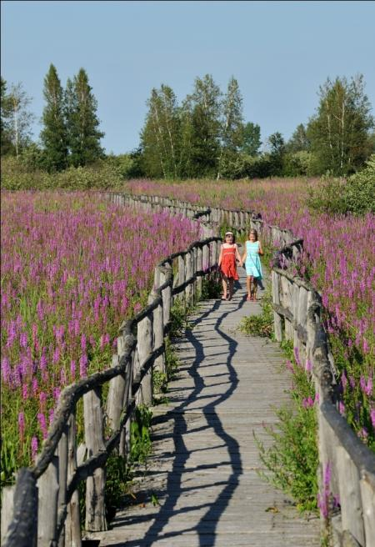
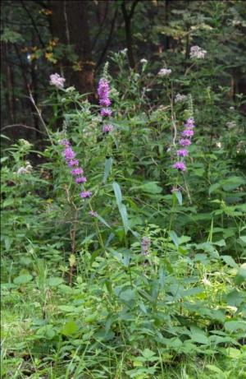





What’s Invasive?
Formal definition – a non-native species that harms people, the environment, or the economy.
Jörg Hempel
Ellen Jacquert
Source: Michigan Natural Features Inventory
Saffron Blaze
Environmental harm – a natural area consisting mostly of one or a combination of introduced plants that provide minimal habitat value.
Notes:
Note formal definition
Walk-thru invasion curve, why it’s important to act early

Slide 8
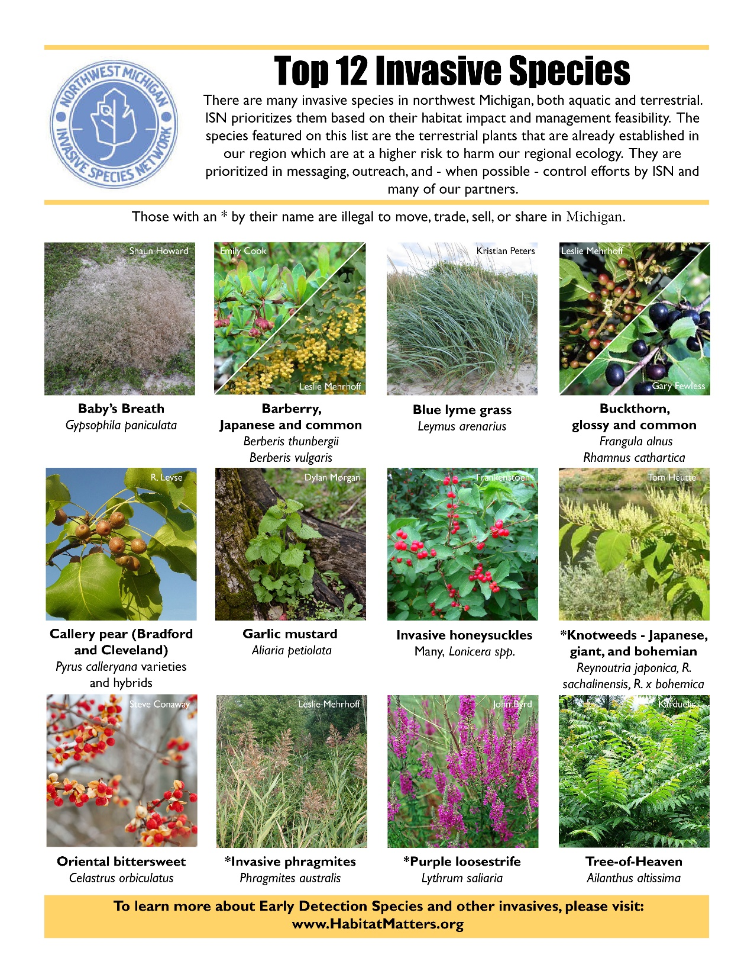
Early Detection Species
Awareness Species
Dune
Field
Forest
Wetland/Riparian
Ornamental
ID booklets on hold for now
Notes:
ISN will use this
Lots to learn—book!
20 is still a lot—we narrowed down to 4 in early invasion stage with high impacts for the area

Slide 9
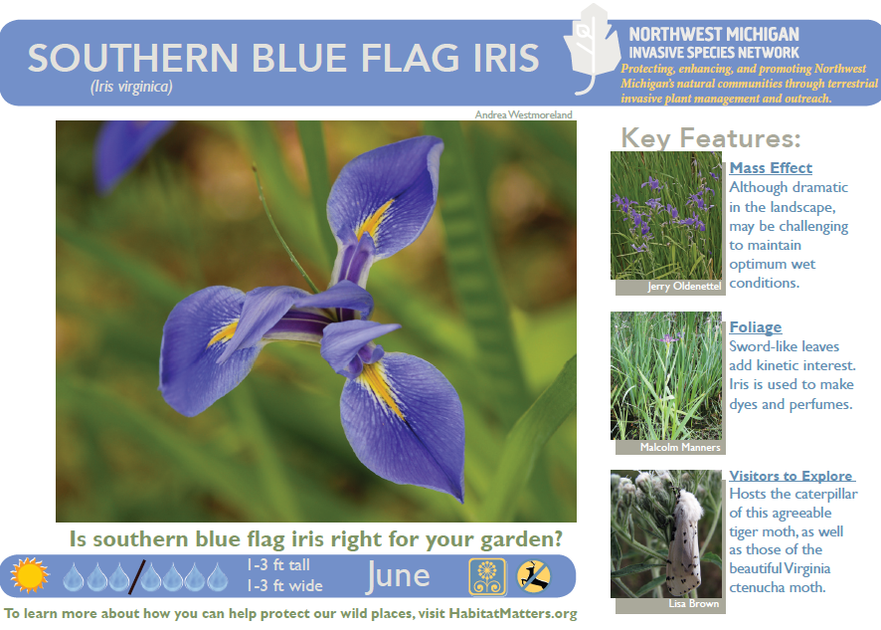
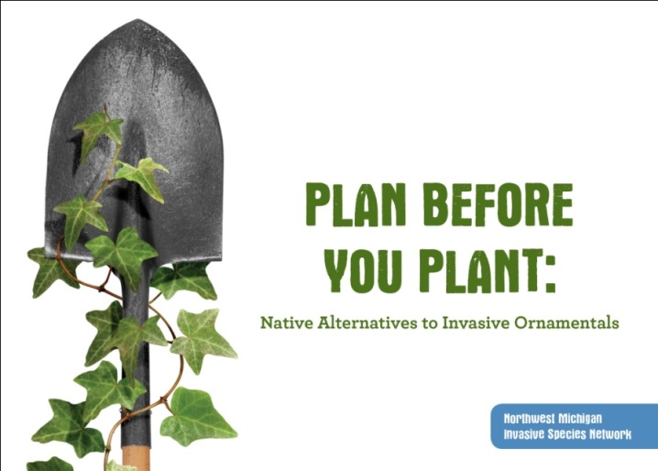
Current Programs
Go Beyond Beauty—a voluntary program to remove invasive ornamentals from local nurseries’ and landscapers’ inventories
Workbees—focused on garlic mustard, baby’s breath, shrubs
Control—high-priority species in
high-quality habitats
  Japanese knotweed, Oriental bittersweet, garlic mustard,
  invasive Phragmites
  Ornamental invasives
  Early Detection species
Outreach—presentations, workshops, resources
  Value of habitat, threat of invasives
  Empower average people to care & make a difference
  Need resources? Ask!
Notes:
More about GBB next
Autumn Berry—I urge people to visit our website about this: http://habitatmatters.org/2013/07/autumnberry-preserves/ It’s a controversial subject; we do NOT condone planting AO (and in fact link to an article all about what to replace AO with!), and will be removing AO in natural areas for each jar sold. That said, Partners decided this opportunity to place messaging on each jar was too good to pass up (we can get ahead of the curve!)
Garlic Mustard Paper is going to be awesome! I wish I could send a sample with you, but we only have a few pieces from the trial run. If all goes as planned this spring, we should have a Holiday 2014 launch.
Workbees—volunteers pulling garlic mustard directly with ISN, though many Partners hold a variety of hikes, workbees, and workshops
Control—physical removal or chemical. Work with Partners to establish highest priority populations & treat what we can fit in the budget! Mainly state land, Partner-managed natural areas, and some roadsides (PH & JK)
Outreach—mainly presentations, also one-on-one and any other opportunities that come up. Anyone who will sit still! ☺

Slide 10
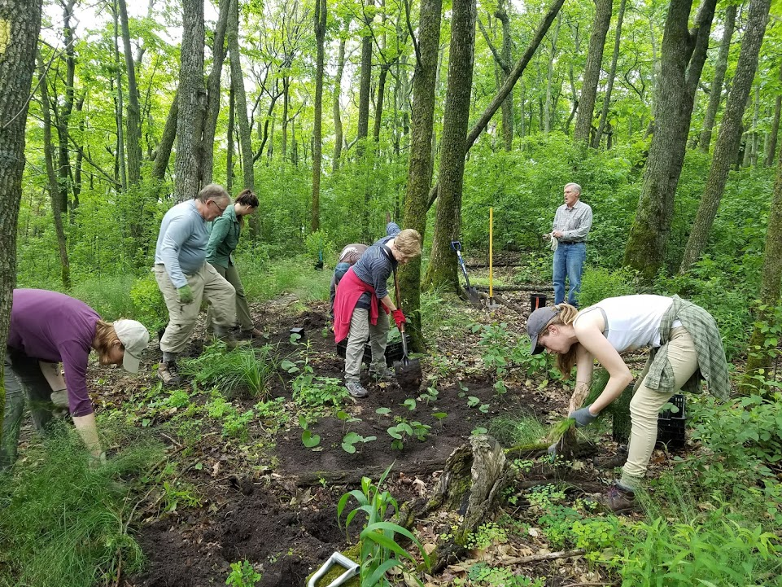
Steering Committee Updates

Slide 11
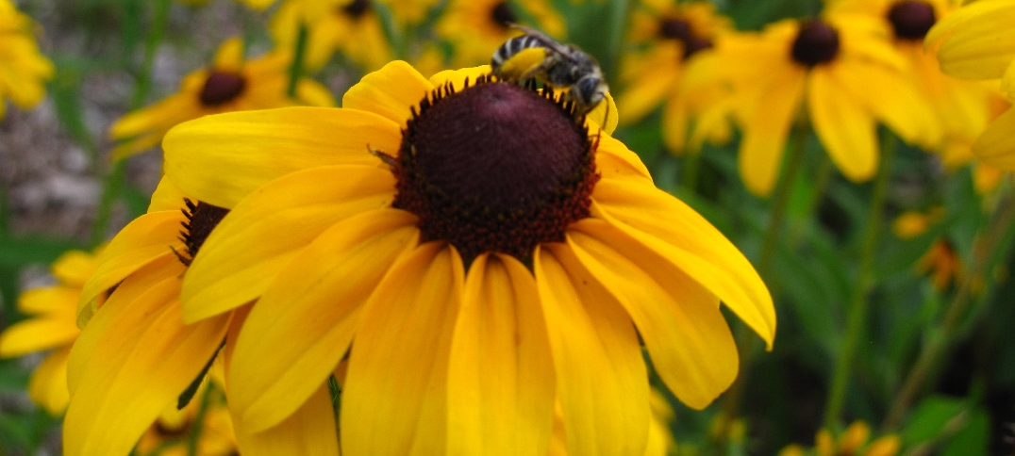
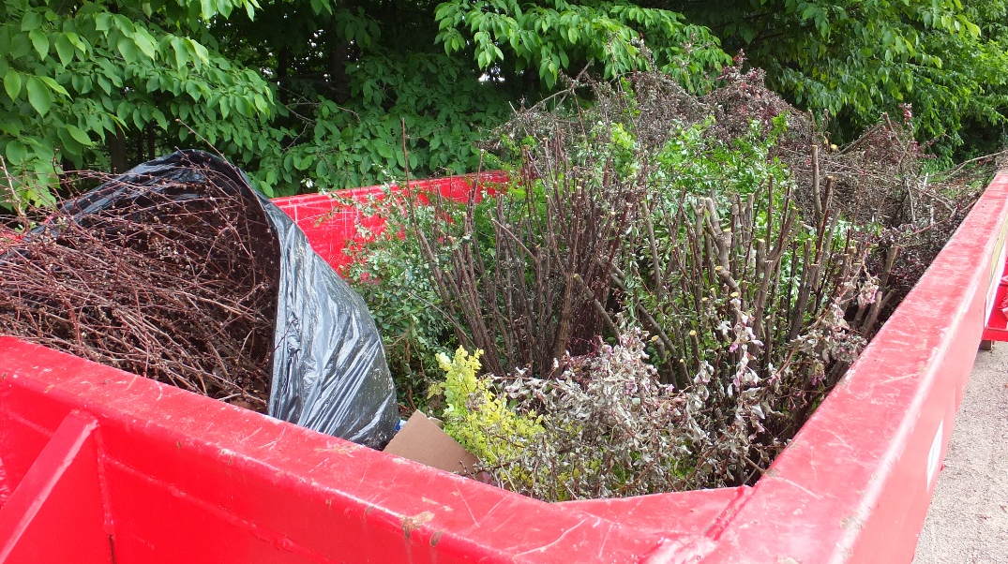
Go Beyond Beauty
MISGP Grant Received – Going statewide!
    Welcome, Shelly ☺
    Next steps
Spring Meeting – Wednesday, April 15
2020 Japanese Barberry Trade-up Days
    Grand Traverse
    TBD
Current participation:
    8 nurseries
    14 landscapers
      Gold Level Achievement – Old Mission Associates
    22 other participants/businesses

Slide 12

Japanese Barberry Trade-up Days
Wednesday, June 17 – Friday, June 19
Boardman River Nature Center
Saturday, June 27 – 1:00pm-3:00pm
TBD

Slide 13
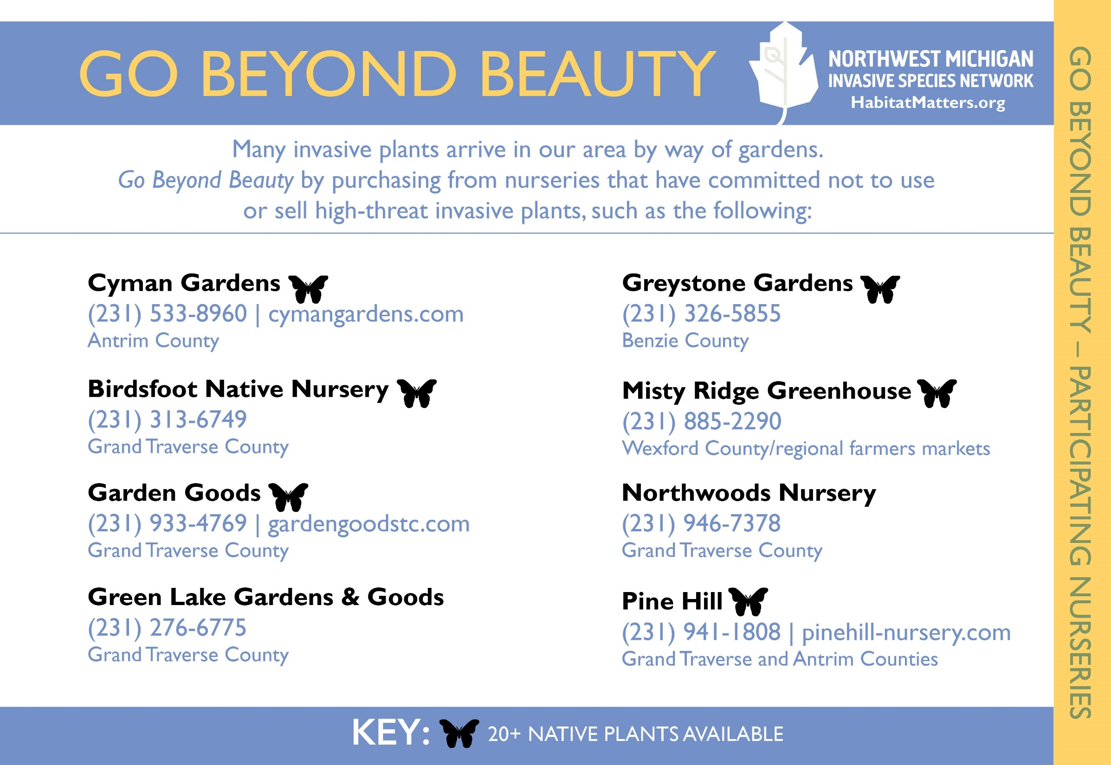

Slide 14

New Participant:
  Greener Earth Landscaping
Insert to be redesigned as participants are changing, achievement levels are added, and new certifications are received.

Slide 15
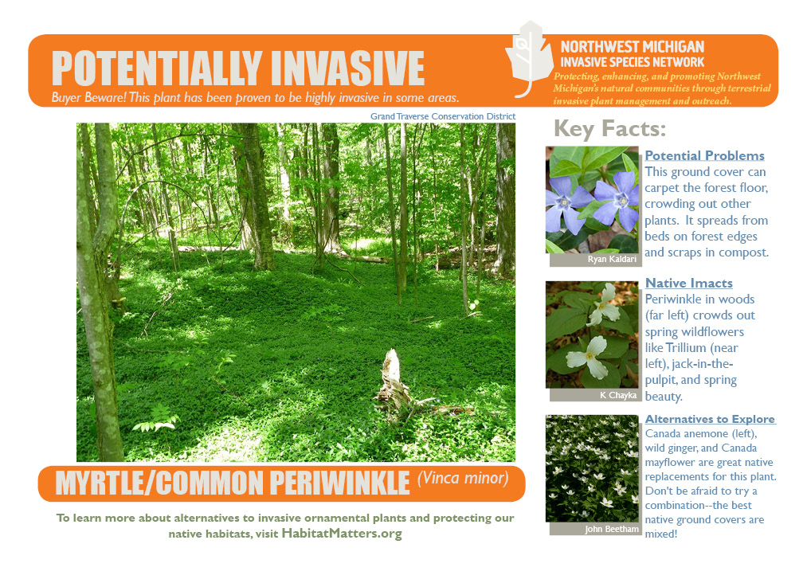
New Project: Invasive Species Signs

Slide 16
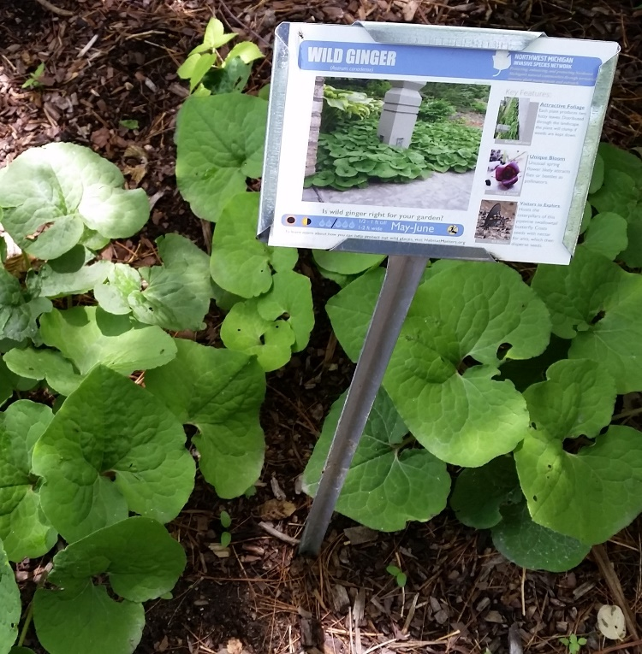
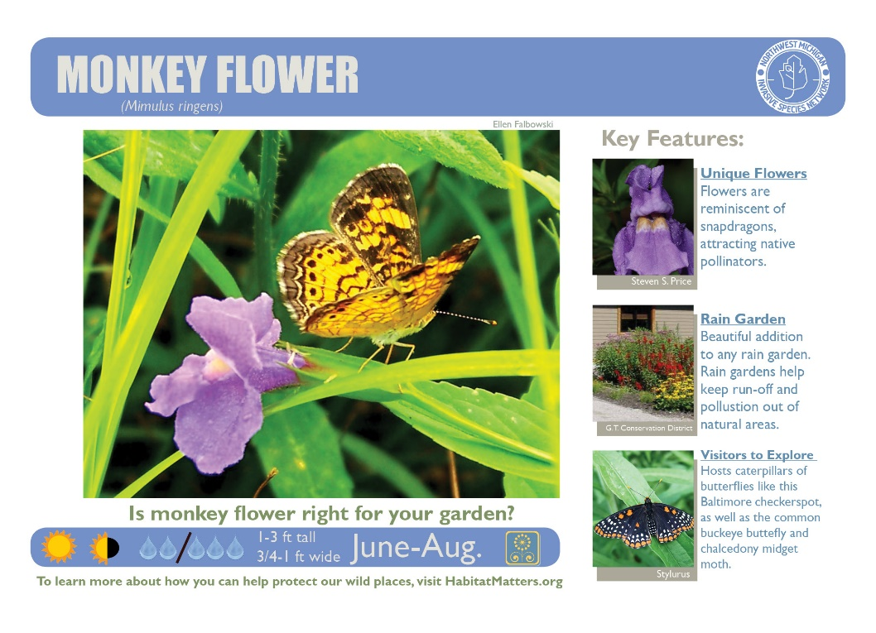
Native Plant Signs Spring Order
Orders Due April 27!
Nearly 300 species available!
7x5” printed on aluminum w/ UV coating & 30” stake
<$10 each (cheaper w/o stake)
Anticipated ready in early-mid May
OR ask for the species you want & we’ll send you PDFs for free to print on your own

Slide 17
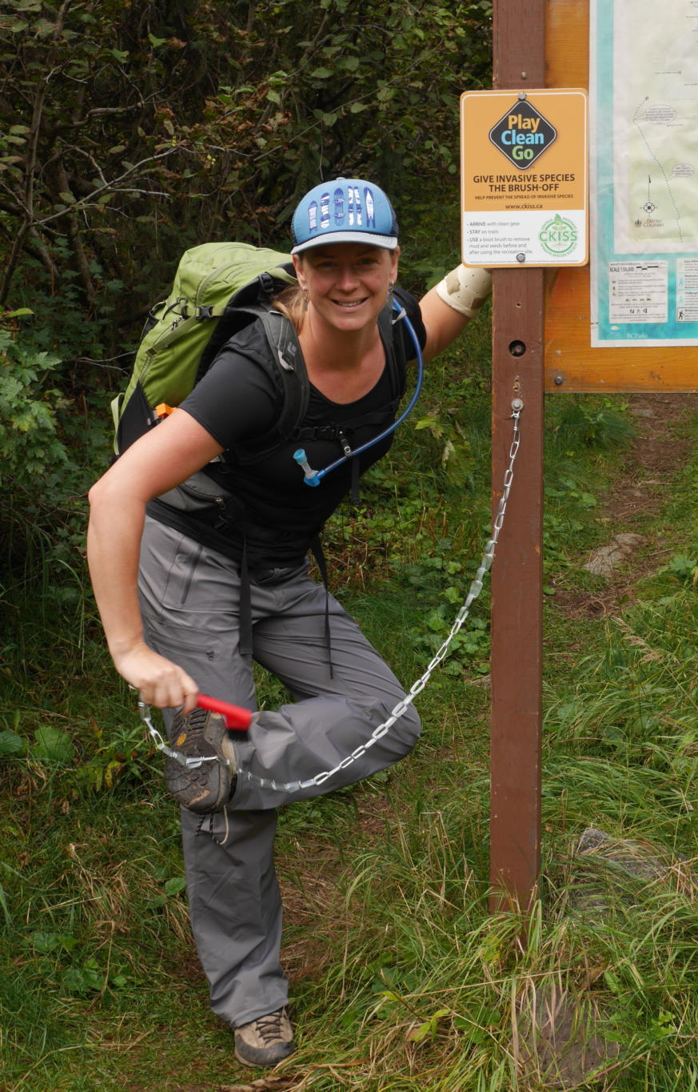
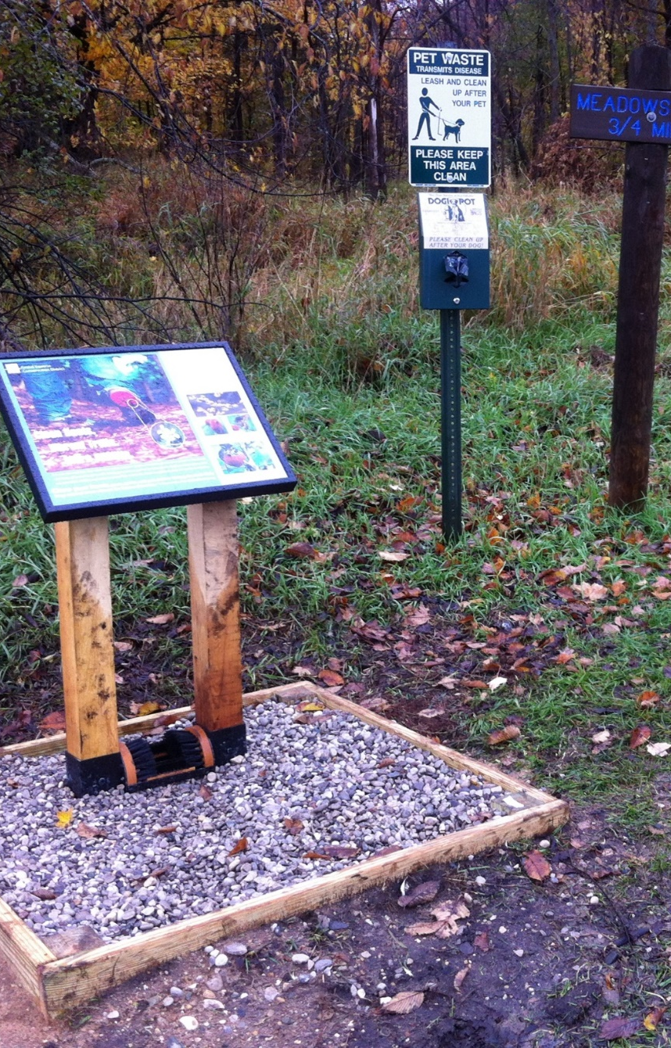
Bootbrush Stations
Sign, station, brush, lumber, $150 cost-share ($300 value)- 8 still available for partners!
  Space on sign for logo sticker
  Need landscape fabric, gravel, concrete, tool/installation
Upgrade or mini-station: scrub brush, cable, & keeper ($20) Lots available!
  Play Clean Go has smaller signs
  Thank you last year participants!
  Au Sable Institute
  Grand Traverse Hiking Club
  Manistee Conservation District
  Michigan Audubon
Photo: Central Kootenay Invasive Species Society
ISN bootbrush station at a trailhead

Slide 18
2020 Workbees and Other Events
Garlic Mustard
    May 9 – Grand Traverse
    May 19 – Manistee
    May 20 – Benzie
    May 21 - Leelanau
Baby’s Breath – June 9, July 7, August 4
ID Trainings (partners only)
    June 4 – Grand Traverse
    June 5 - Manistee
Japanese Barberry Dumpster Days – June
Japanese Knotweed Workshop
    June 24 - Benzie
Autumn Olive Workshops
    August 27 – Grand Traverse
    September 3 - Manistee
Changes to events/outreach with ongoing cancellations:
Garlic mustard challenges, by county – tentatively planned for National Invasive Species Awareness Week (May 18-22)
Tutorial videos – creating an ISN YouTube channel
    Garlic Mustard ID and removal
    Decontamination
    ISN Introduction
    Treatment how-to (mechanical and chemical)
    Others?
    **some contracted out, others made in-house**
Possibility of future workshops becoming webinars, TBD
Boat wash events and bike race decontamination booth – planning in progress/some already postponed, TBD
Visit www.HabitatMatters.org/events for more information!

Slide 19
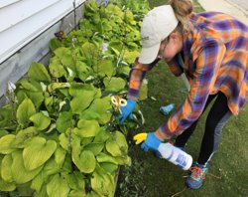
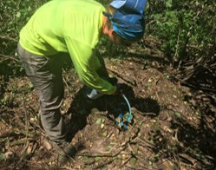
Treatment & Survey Goals for 2020
  Treatment: 600 Acres
Invasive Ornamentals (medium to large scale populations)
Satellite Sites
Prevention-based Control
Focus 4 & other High Priority/ Top 12 Species
Early Detection & Response Treatments (Swallow-wort!)
Biocontrol Sites
  Survey: 700 Acres
Assessing & Monitoring Treatment Sites
Surveying New Areas for Invasive Species
Site Visits to Private Properties
Early Detection & Response
Contact Audrey with Survey Ideas!
Treatment Sites:
-Private Properties -DNR
-USFS -Natural Areas
-Municipalities -MDOT
-Audubon -Road Commissions
Treating swallow-wort in Kingsley.
Using an herbicide foamer for cut stump.

Slide 20
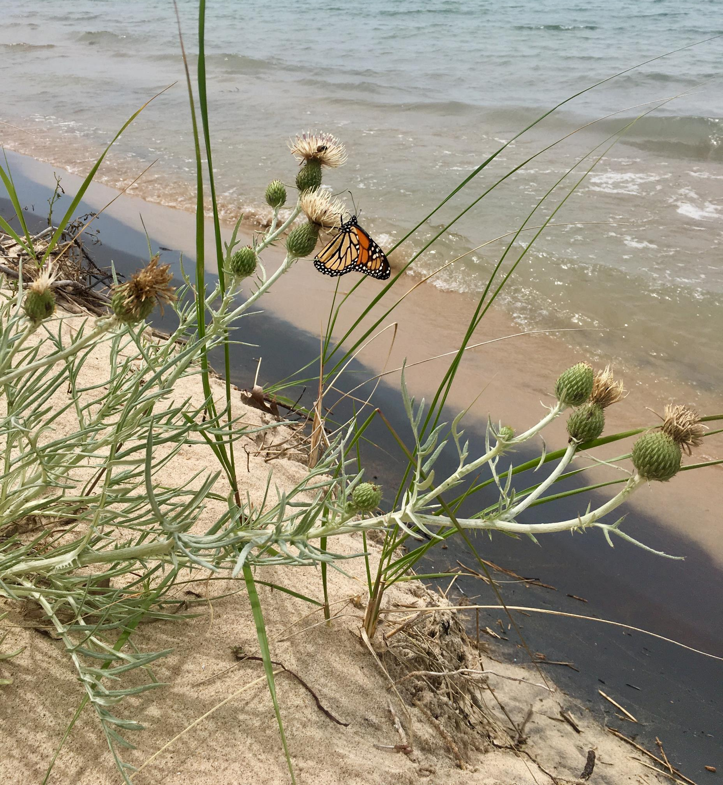
Field Season—Crew
Hired crew!
  Welcome to Abagail Boyd and Sarah Cole
  Tentative start date of May 4th
Species sneak peak!
  Swallow-wort, knotweed, phragmites, invasive bittersweet, garlic mustard
Need a survey done? Good. We need rainy day tasks!
  amenninga@gtcd.org

Slide 21
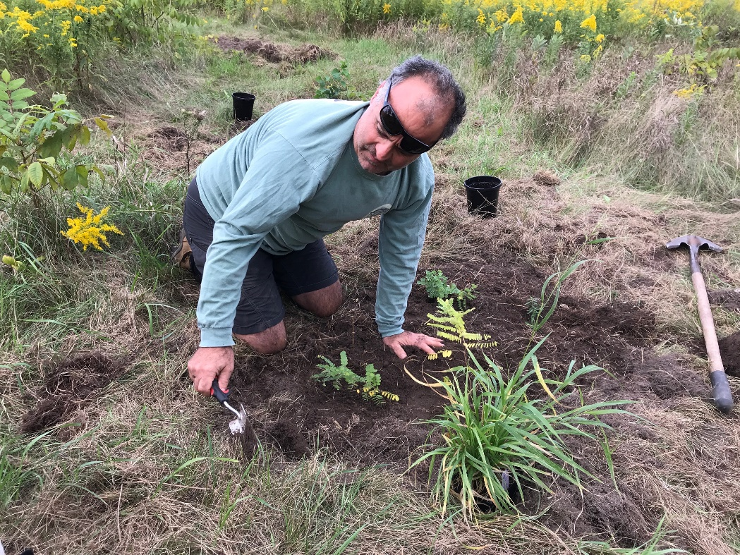
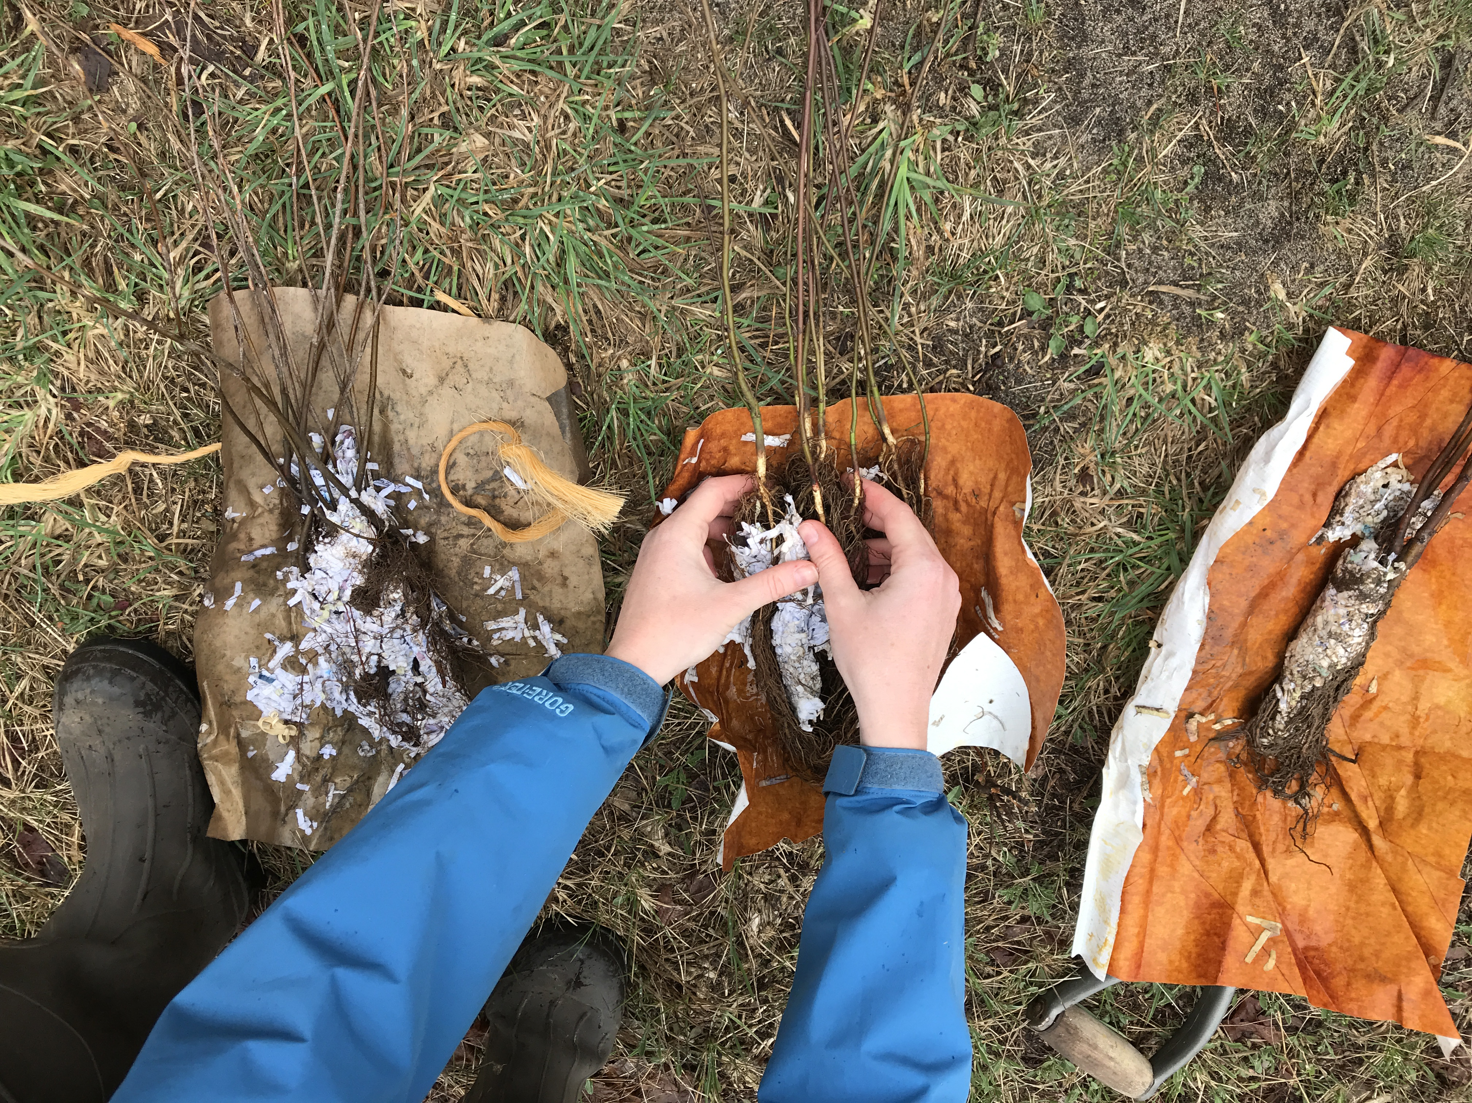
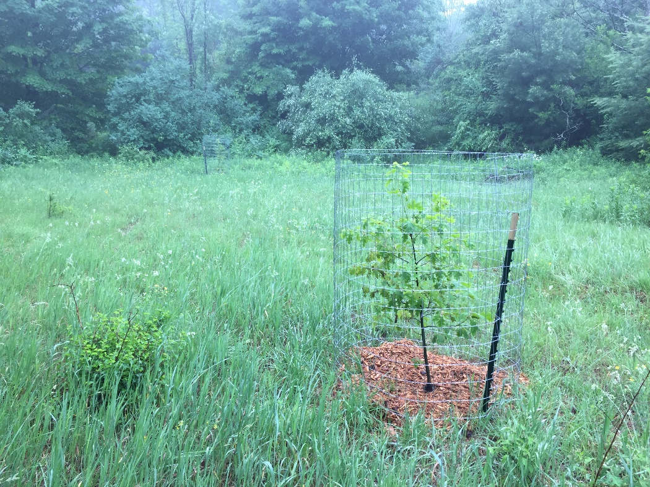
Restoration for 2020
1,000 Native trees & shrubs available for partners!
Pick up & delivery- Scheduled for May but subject to change under circumstances
Areas of previous treatment OR areas
at high risk of invasion a “plus”
  Generally high-quality sites that just need “help”
  Additional funding for partner projects may be available
  Need 15 acres
Maple Bay Natural Area Wetland Restoration
Some Species on List:
American Elder
Black Chokeberry
Common Ninebark
Eastern Red Cedar
Gray Dogwood
Nannyberry
Red-Berried Elder
Spicebush
Tamarack
*Ask for the full list!
Getting seedlings ready at Chippewa Run Natural Area
Planting trees at Traverse City Light & Power property

Slide 22
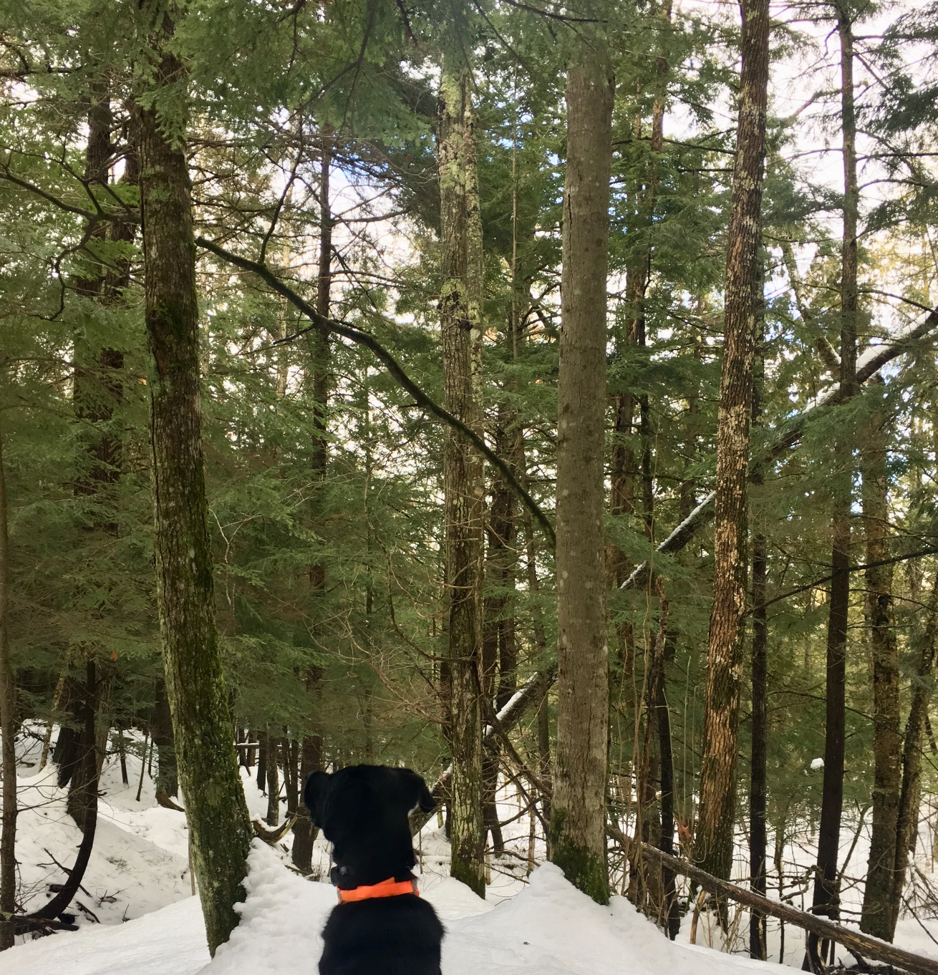
HWA Survey Updates
Surveys are complete for the 2020 season due to stay-at-home restrictions.
Acres: 1203
Sites: 113
  Public: 30
  Private: 82
Significantly milder winter!
Possible extension for the grant due to an early cut-off and extra grant money.
  Winter 2021—thoughts on focus areas?

Slide 23
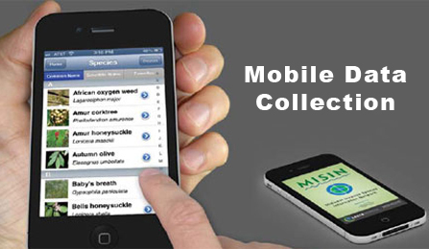
MISIN www.misin.msu.edu
Data Submission
  Web
  App (Apple & Android)
Identification resources
  1pg (Species Information)
  Training modules (Tools>>Training Modules)
Treatment Tracking

Slide 24
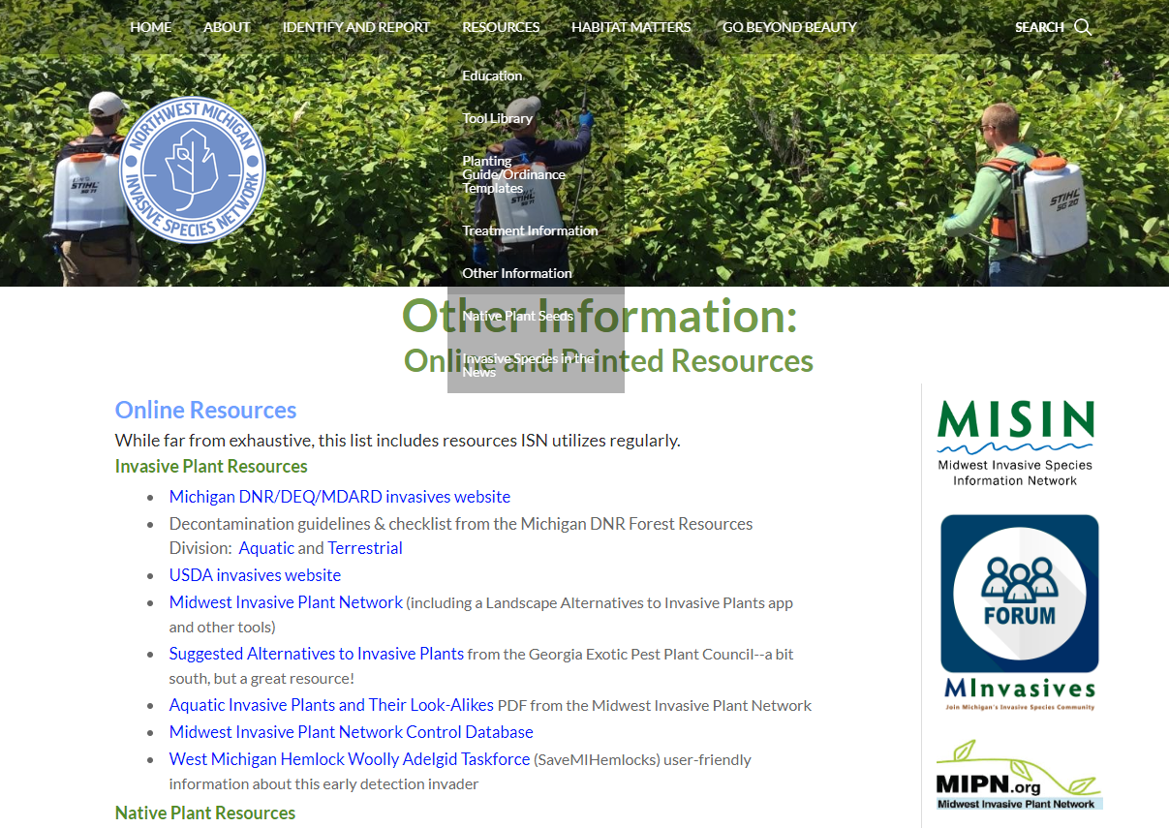
Resources Reminder
HabitatMatters.org/other-information
  Decontamination Protocols
  Planting Guides (municipalities)
  Print & Online resource lists
MISC Forum (forum.michiganinvasives.org/)

Slide 25
Grants Update
Current Grants
Fully funded through June 2021
Strongly funded to 2022
MISGP 2018 CISMA
  Closing out
MISGP 2018 Project
  2020 Crew
  Treatments, outreach, “leadership in IS work”
TNC HWA subgrant
  Closing out?
MISGP 2019 CISMA
  Basic functions, outreach
MISGP 2019 GBB
  Strengthen current program
  Bring GBB state-wide!
USFS CWMA 2019
  Treatment, outreach, staff time

Slide 26
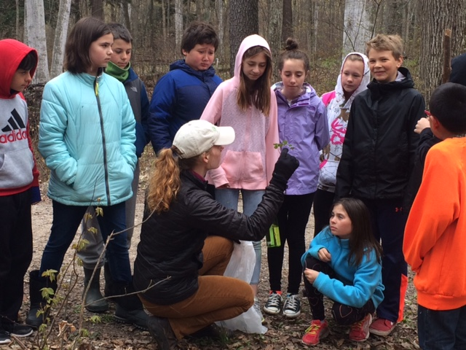
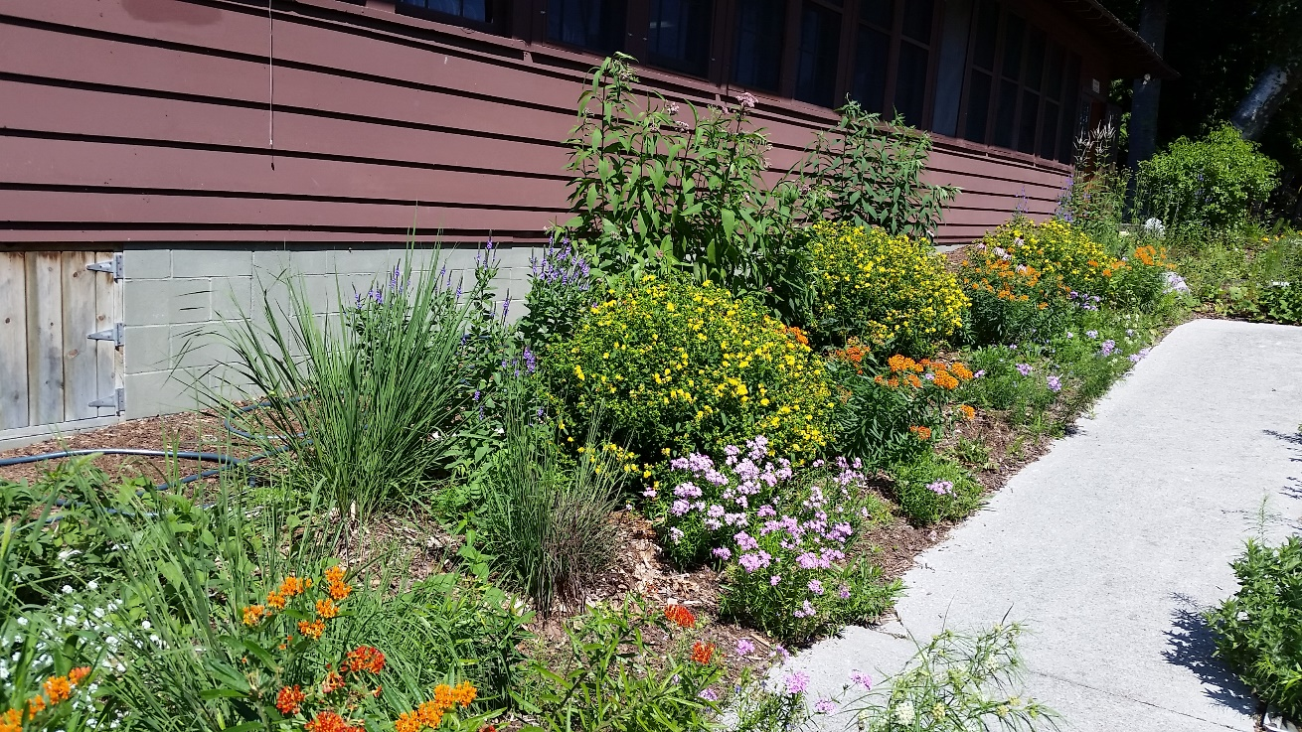
Upcoming Grants
USFS CWMA 2020 (submitted—pending)
Good Neighbor Authority (USFS/DNR) 2019—expected, pending
MISGP 2020 (RFP in June?)
Others?

Slide 27





State-wide & Regional Updates
Michigan Invasive Species Coalition
Play, Clean, Go
MIPN & WIGL Collaborative

Slide 28
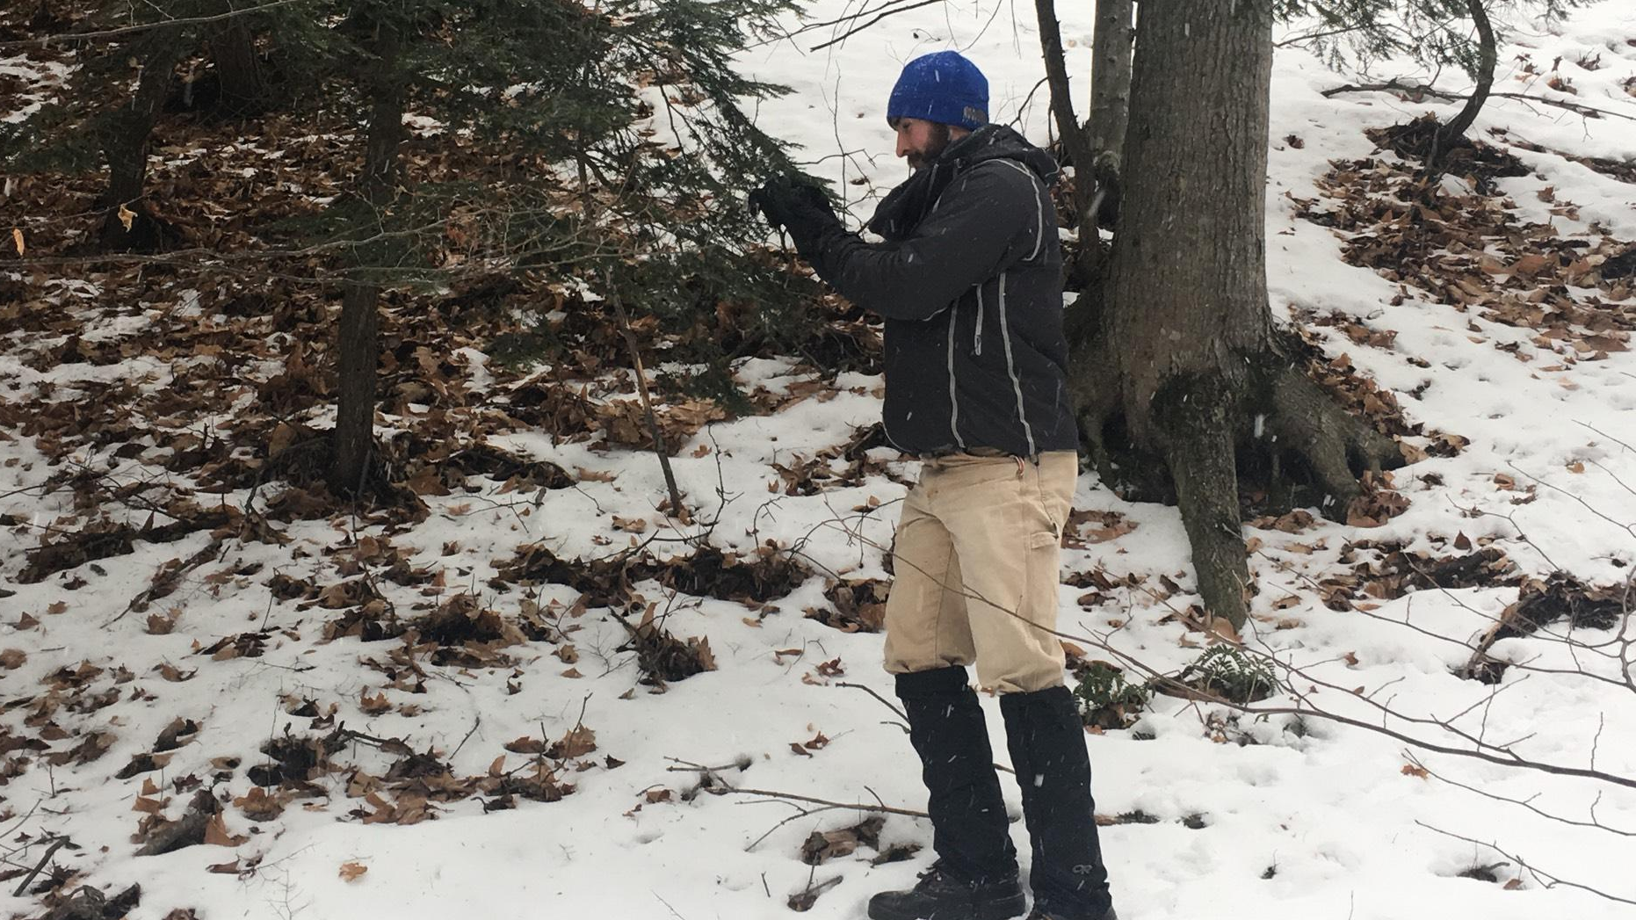
Partner Updates!
2 minutes each, please

