Slide 1
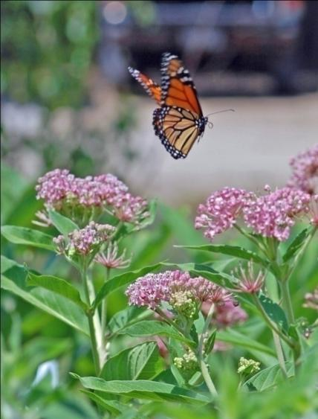
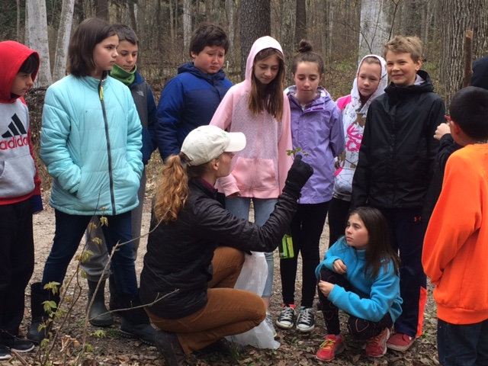
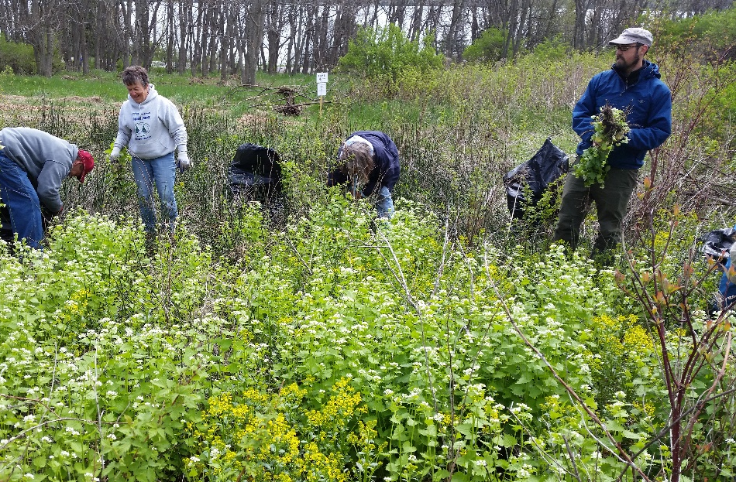
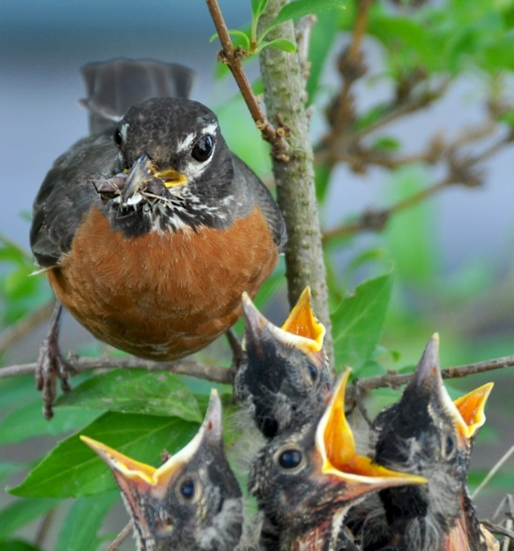
Northwest Michigan Invasive Species Network
Fall 2020
Partner Meeting
Notes:
Development process, bones of GBB, how we’ve grown & changed, and plans for the future, plus stumbling blocks

Slide 2
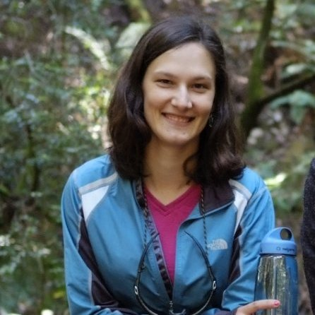
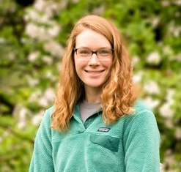
ISN Staff
Katie Grzesiak, Coordinator
Emily Cook, Outreach Specialist
Shelly Stusick, GBB Specialist
Fields Ratliff, Habitat Mgmt Specialist
Audrey Menninga, Inv. Spp. Specialist

Slide 3
Funded in part by:
Michigan Invasive Species Grant Program Great Lakes Restoration Initiative
Good Neighbor Authority
Major Partners
…and many, many more!

Slide 4
ISN Goals
Raise awareness of high-priority invasive species in the region through education in order to cultivate long-term stewardship of our natural areas
Prevent introduction and spread of terrestrial invasive plants through outreach and collaboration with government officials and garden professionals
Survey region for high-priority terrestrial invasive plants to aid in effective prioritization and treatment strategies
Facilitate and assist with treatment of high-priority species on public and private land based on survey maps and prioritization strategies

Slide 5
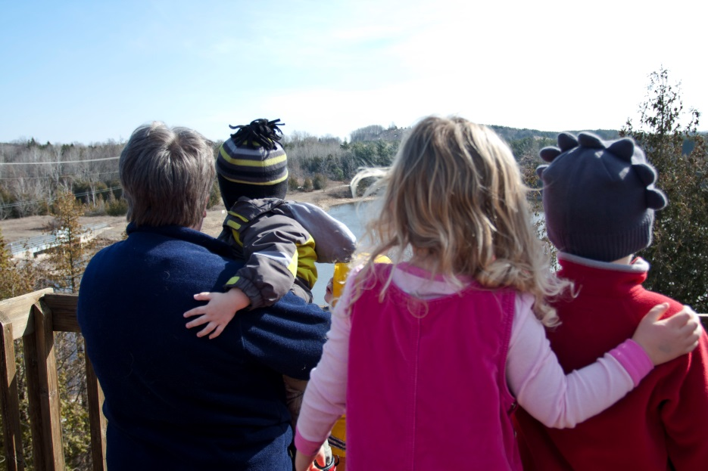
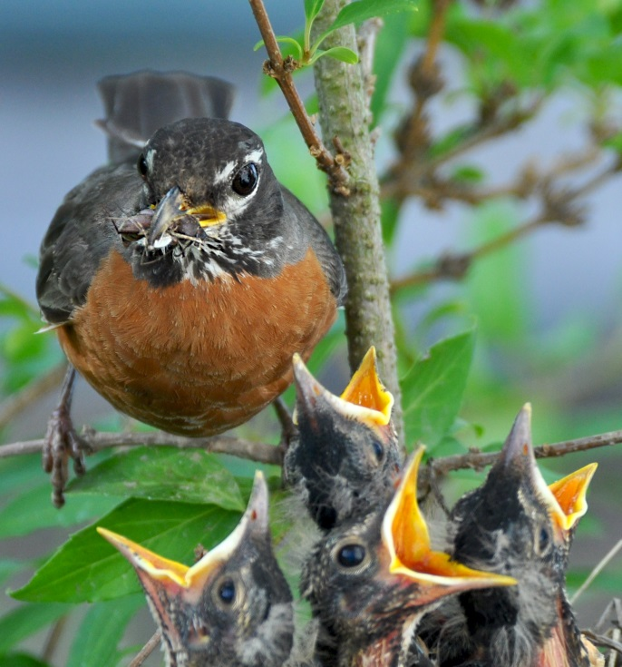
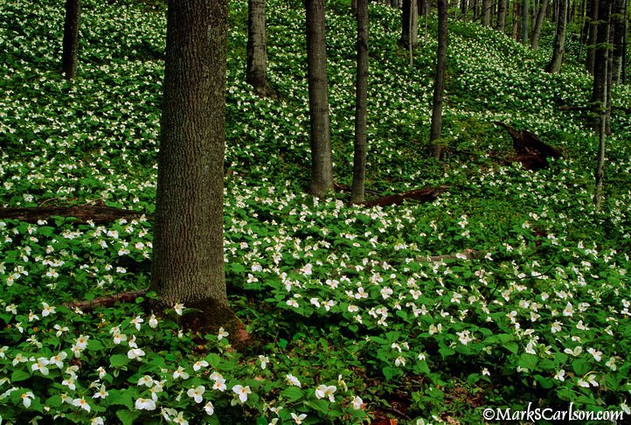
Habitat Matters
For People
For Wildlife
For Northwest Michigan

Slide 6
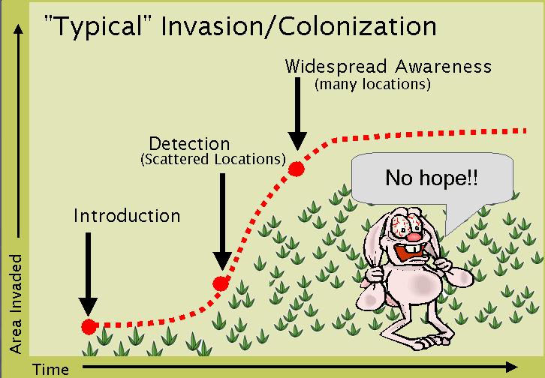
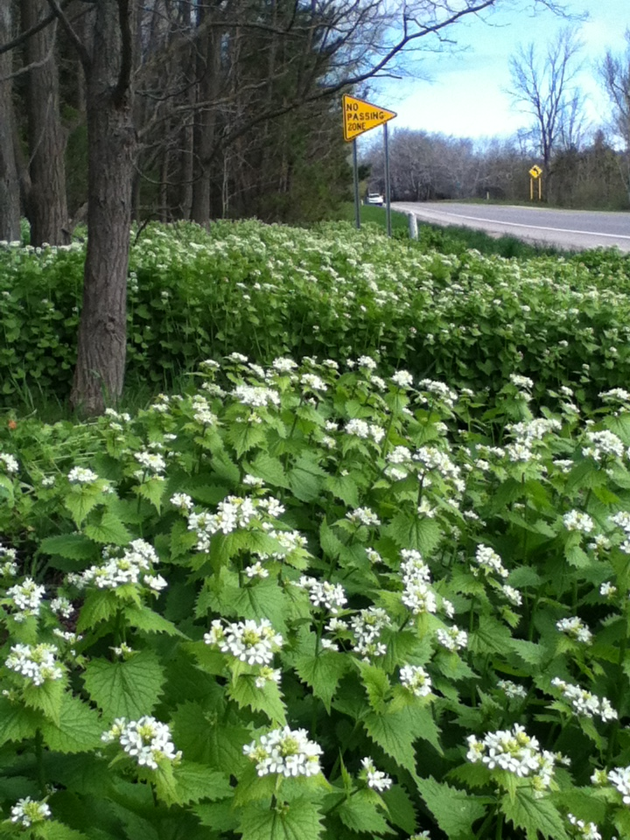
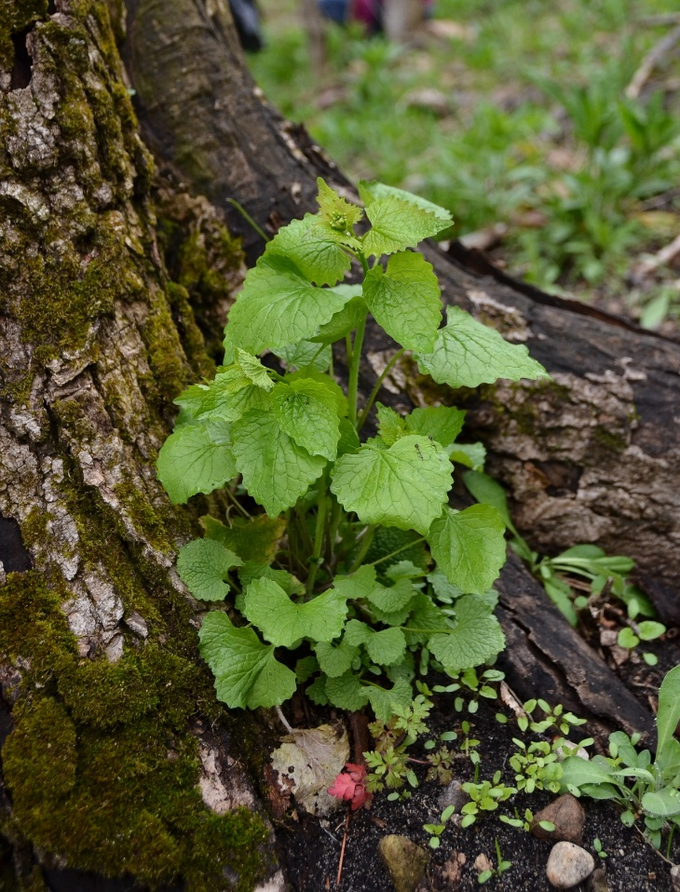
What’s Invasive?
Formal definition – a non-native species that harms people, the environment,
or the economy.
Ellen Jacquert
ISN
Michigan Natural Features Inventory
Environmental harm – a natural area consisting mostly of one or a combination of introduced plants that provide minimal habitat value.

Slide 7
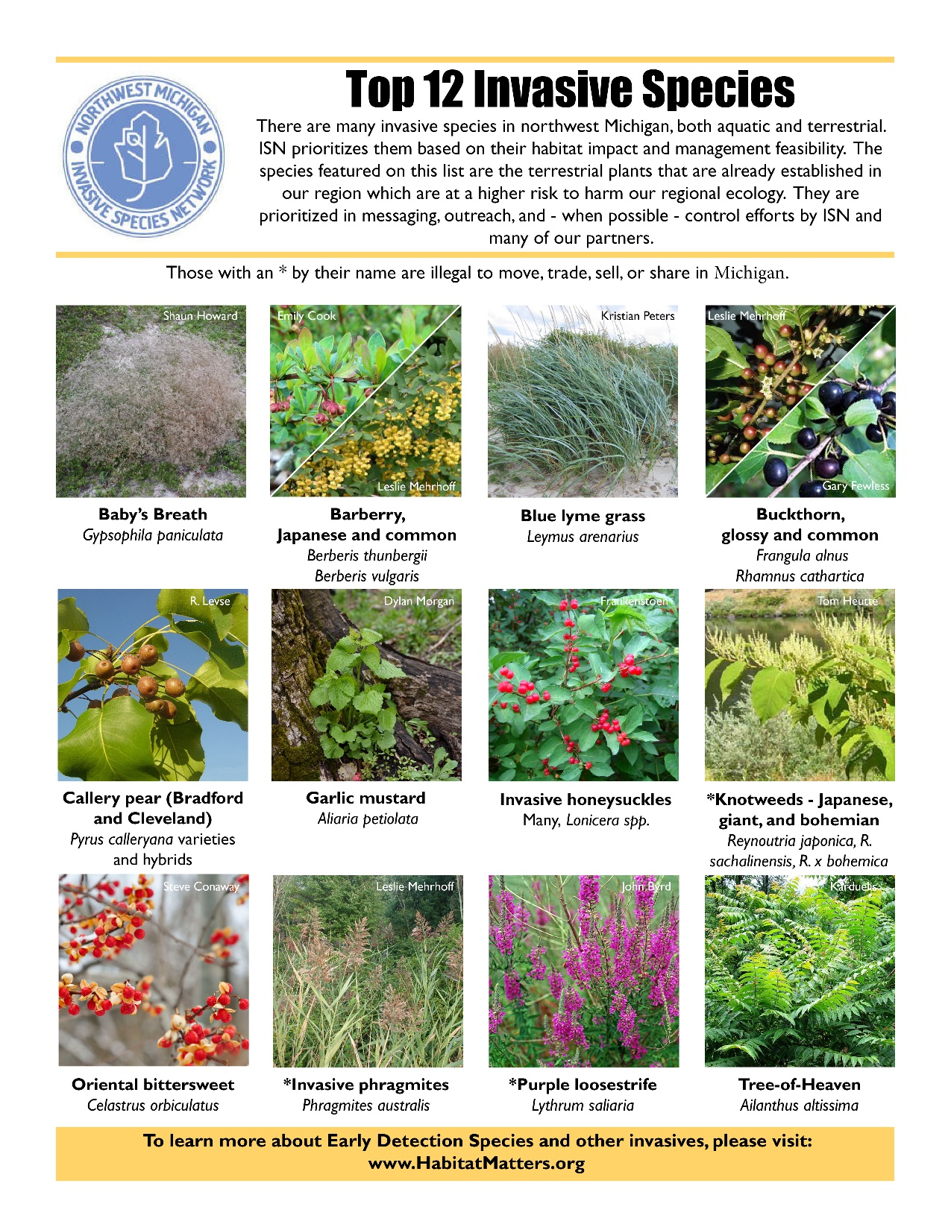
Early Detection Species
Awareness Species
Dune
Field
Forest
Wetland/Riparian
Ornamental
Notes:
ISN will use this
Lots to learn—book!
20 is still a lot—we narrowed down to 4 in early invasion stage with high impacts for the area

Slide 8
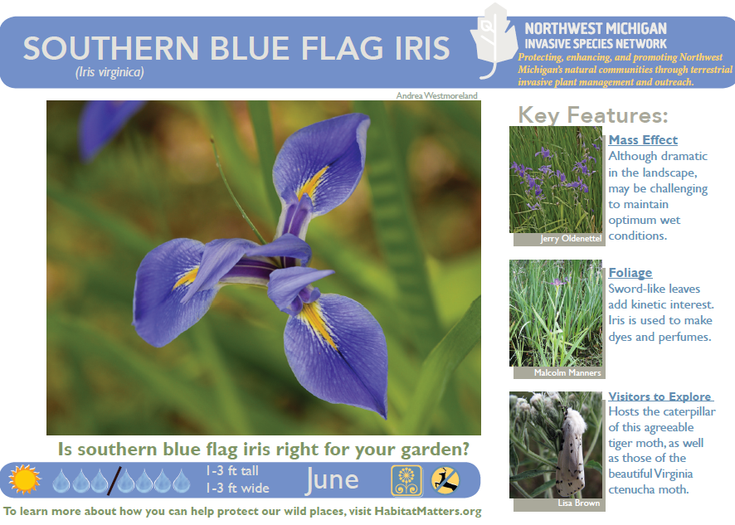
Current Programs
Go Beyond Beauty—a voluntary program to remove invasive ornamentals from local nurseries’ and landscapers’ inventories
Workbees—focused on garlic mustard, baby’s breath, shrubs
Control—high-priority species in high-quality habitats
Japanese knotweed, Oriental bittersweet, garlic mustard, invasive Phragmites
Ornamental invasives
Early Detection species
Outreach—presentations, workshops, resources
Value of habitat, threat of invasives
Empower average people to care & make a difference
Need resources? Ask!
Notes:
More about GBB next
Autumn Berry—I urge people to visit our website about this: http://habitatmatters.org/2013/07/autumnberry-preserves/ It’s a controversial subject; we do NOT condone planting AO (and in fact link to an article all about what to replace AO with!), and will be removing AO in natural areas for each jar sold. That said, Partners decided this opportunity to place messaging on each jar was too good to pass up (we can get ahead of the curve!)
Garlic Mustard Paper is going to be awesome! I wish I could send a sample with you, but we only have a few pieces from the trial run. If all goes as planned this spring, we should have a Holiday 2014 launch.
Workbees—volunteers pulling garlic mustard directly with ISN, though many Partners hold a variety of hikes, workbees, and workshops
Control—physical removal or chemical. Work with Partners to establish highest priority populations & treat what we can fit in the budget! Mainly state land, Partner-managed natural areas, and some roadsides (PH & JK) Outreach—mainly presentations, also one-on-one and any other opportunities that come up. Anyone who will sit still! ☺

Slide 9
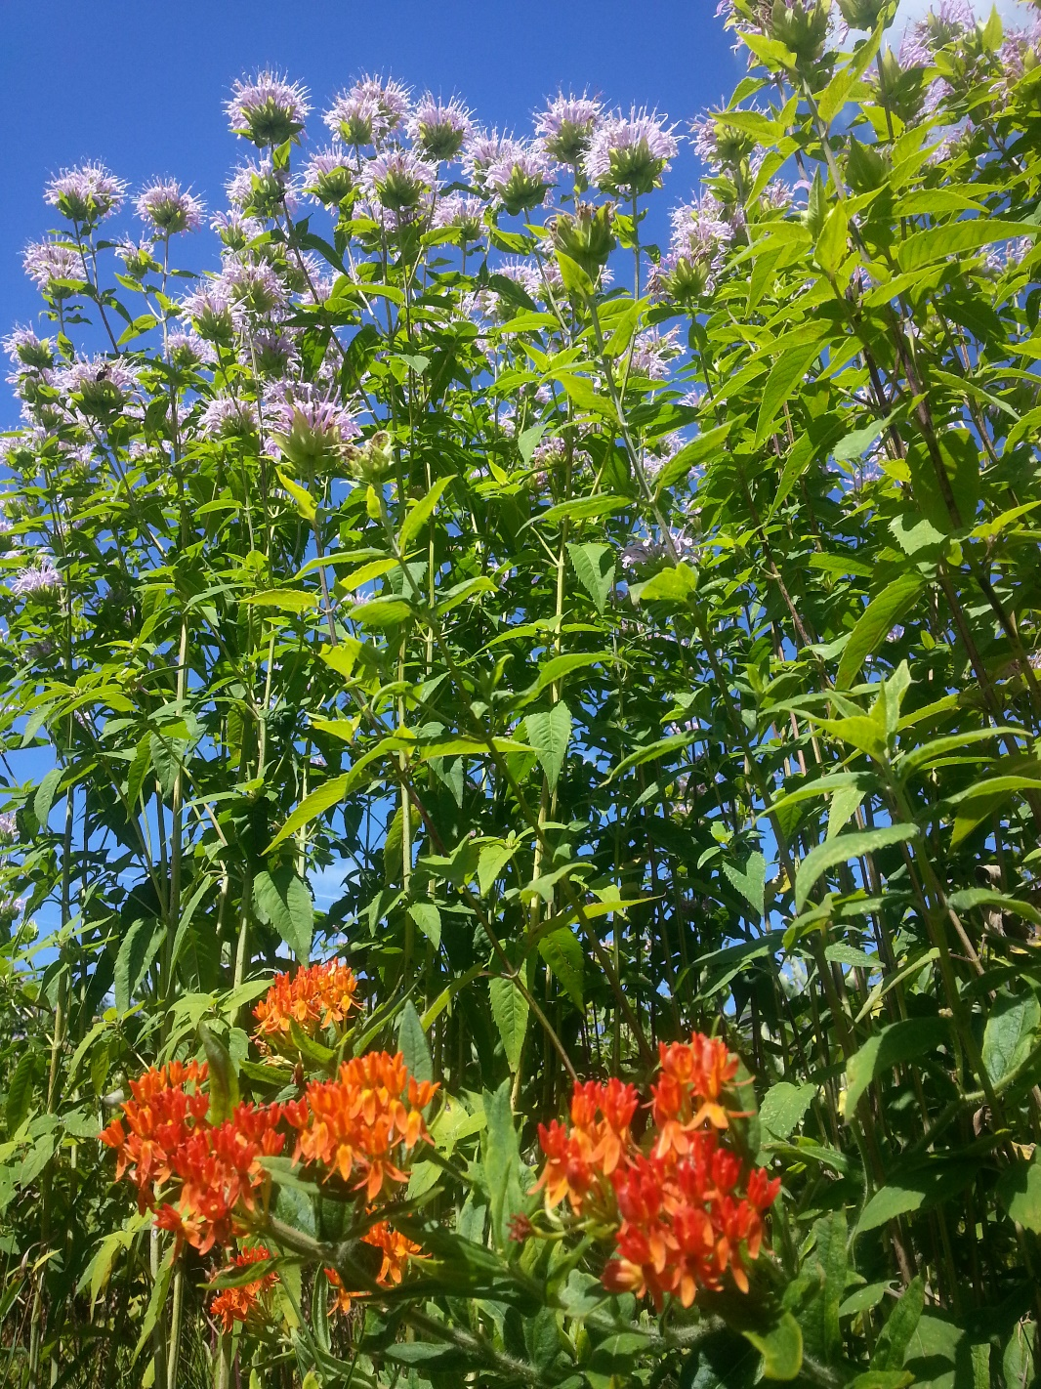
Thank You!
COVID Challenges
Funding Challenges
Event/volunteering Challenges

Slide 10
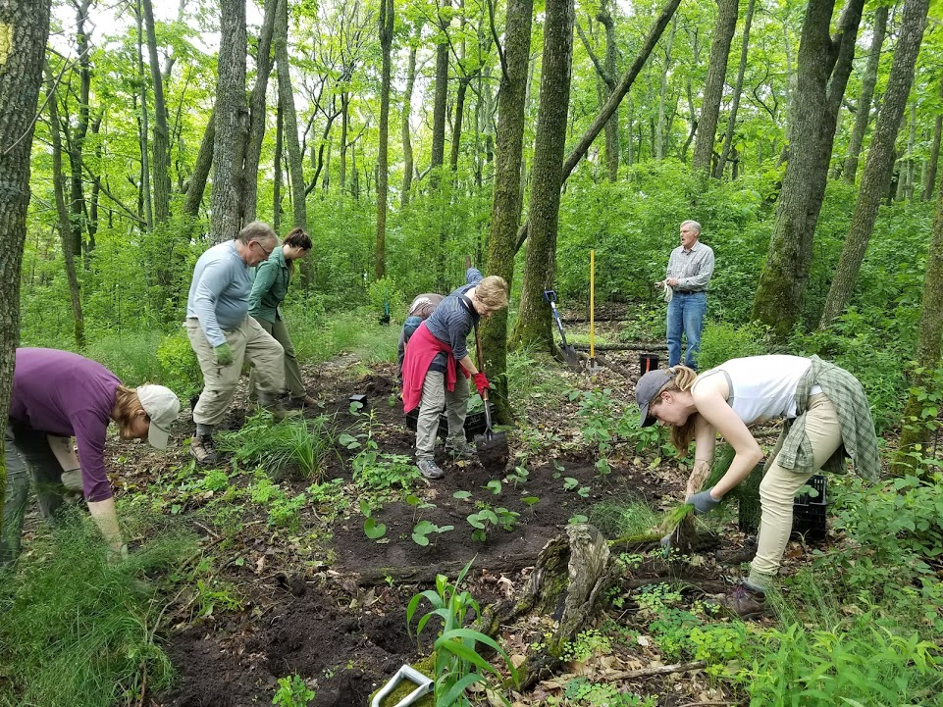
Steering Committee Updates

Slide 11
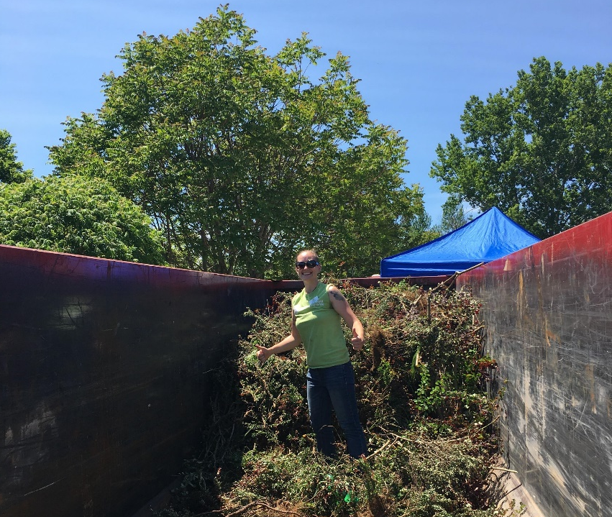
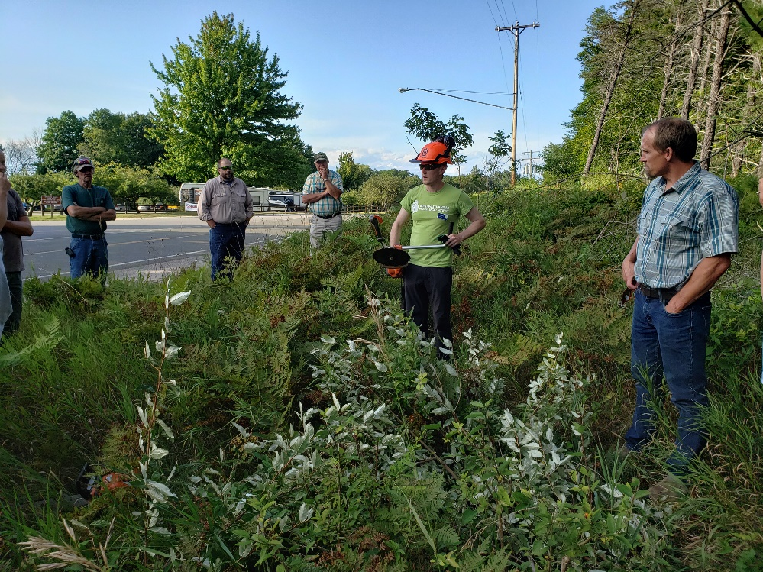
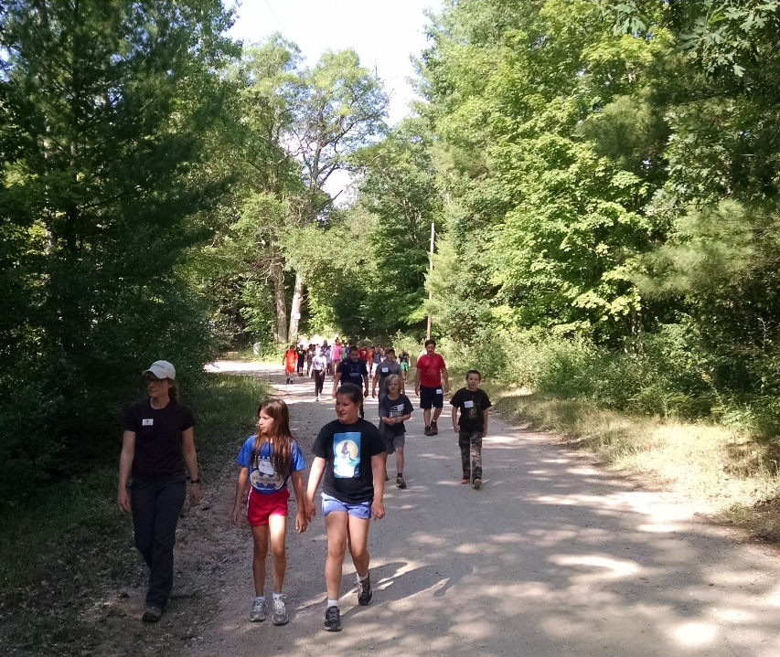
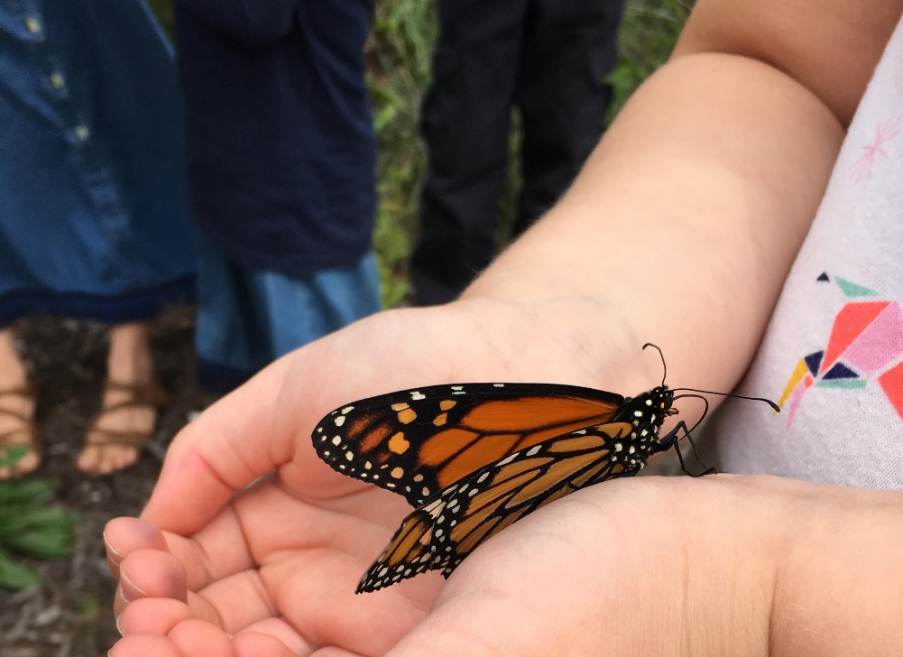
Outreach and Community Events Update

Slide 12
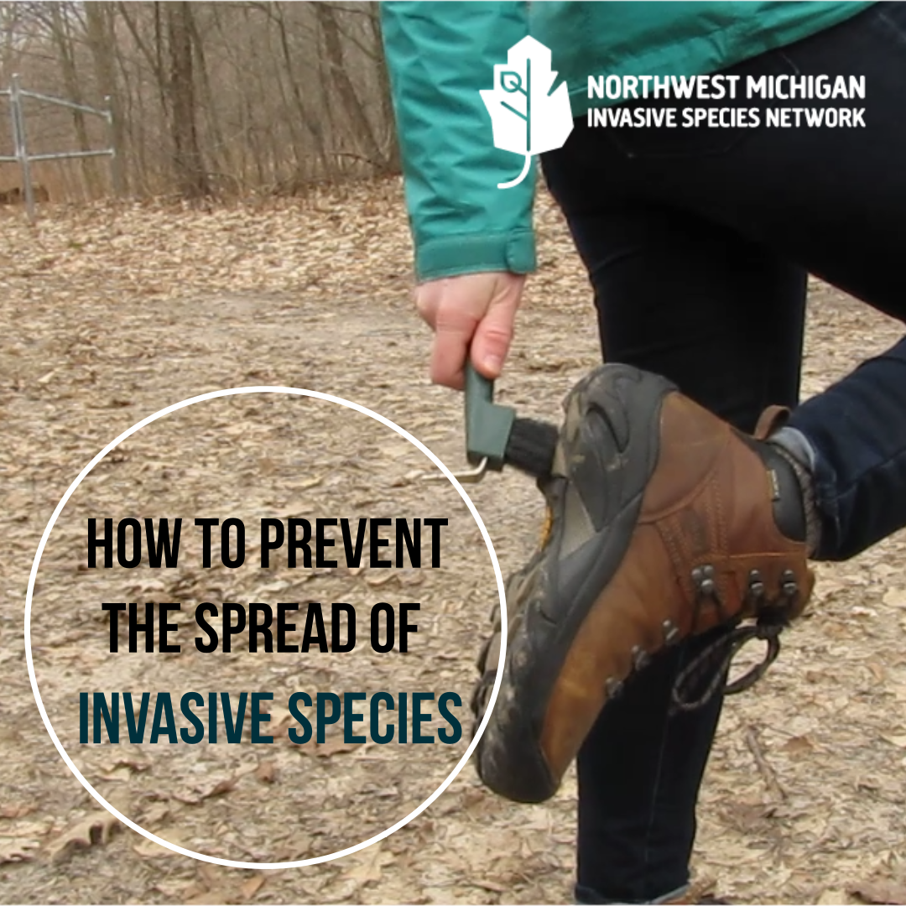
2020 Outreach
Most outreach efforts were paused April – August
Virtual trainings – Japanese knotweed and autumn olive trainings/workshops
YouTube Channel started
ISN introduction video
Workshop recordings
ID videos – posted and ongoing
PlayCleanGo messaging
New resources created
Door hangers – purple loosestrife → coming soon: callery pear and tree-of-heaven

Slide 13
Resources – What do YOU want?
Doorhangers
Plan Before You Plant Brochures/other GBB items
Boot brushes
ISN rack cards
Native Plant Signs
Tentatively planning on a spring order
Contact us or visit website for full list
Field Guides
We are down to one box…
Order more “as is” or revamp?
Currently missing some species after reprioritization

Slide 14
Looking Ahead…What’s Next?
Planning on another “virtual and distant” year…
Winter website revamp – make resources more accessible
Virtual presentations/trainings
Ongoing social media presence/Enewsletter
Facebook, Instagram, and Twitter
Japanese Barberry Trade-up Days
Garlic mustard dumpsters
Socially distant workbees
Garlic mustard and baby’s breath
Increase video resources
Treatment how-to, more ID videos, etc.
Take the 2021 Outreach Survey!
www.HabitatMatters.org

Slide 15
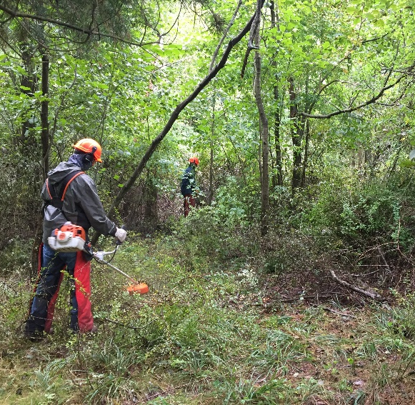
ISN Management Efforts 2020
~Contractors at work~
Over 250 Acres Treated
Garlic Mustard
Phragmites
Woody Invasives
Places & Partners
Conservancy natural areas & preserves
Multiple Lake Associations
DNR- State Game Area, parks, & state forest
Work is still going!

Slide 16
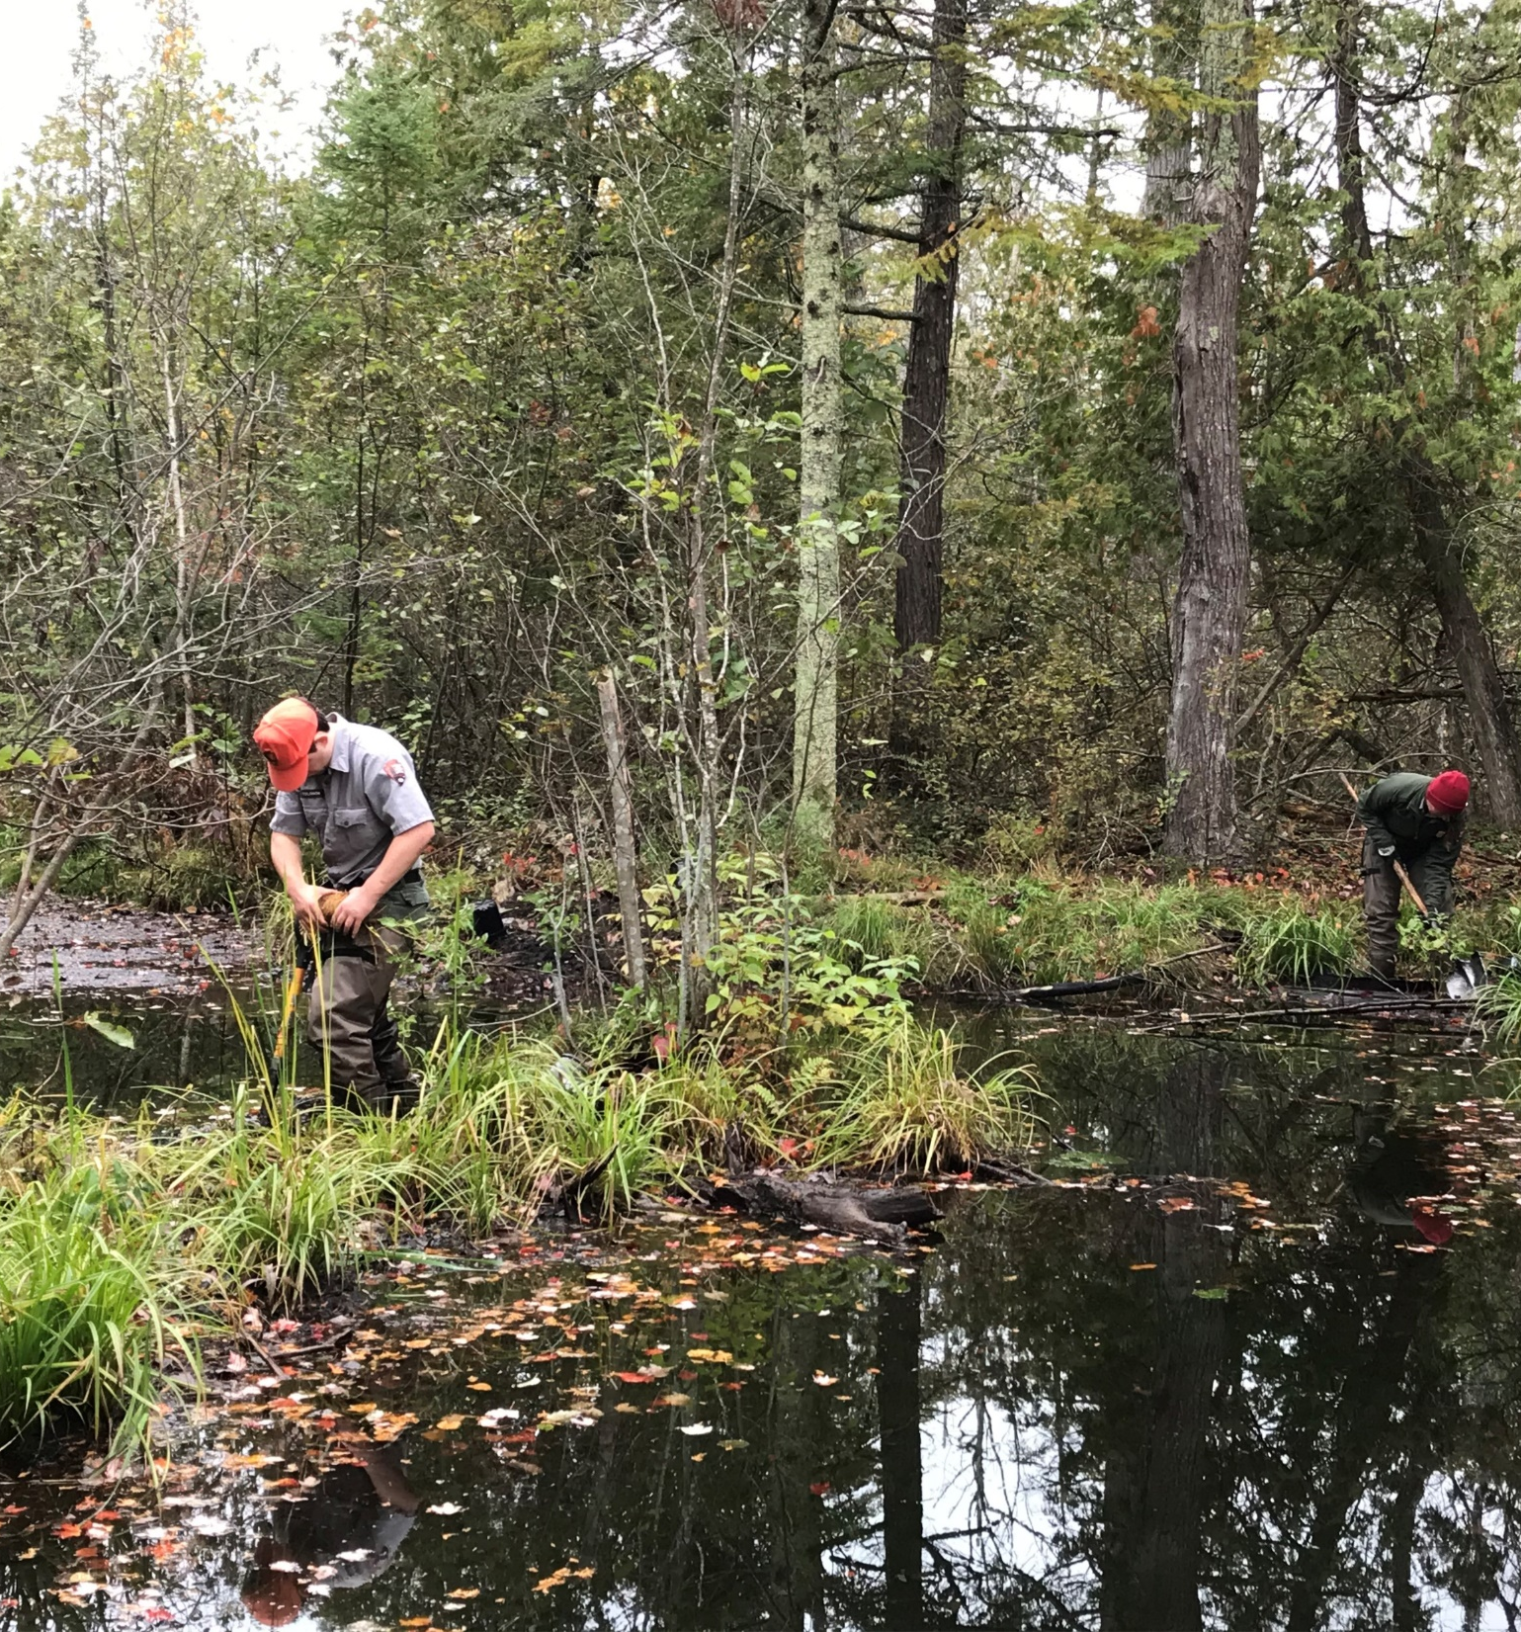
Restoration 2020
Focused on areas of previous treatment OR areas at high risk of invasion a “plus”
25 different species, 30 acres restored!
Provided Seedlings to Multiple Partner Projects:
GTCD Parklands
Grand Traverse Regional Land Conservancy
Leelanau Conservancy
Sleeping Bear

Slide 17
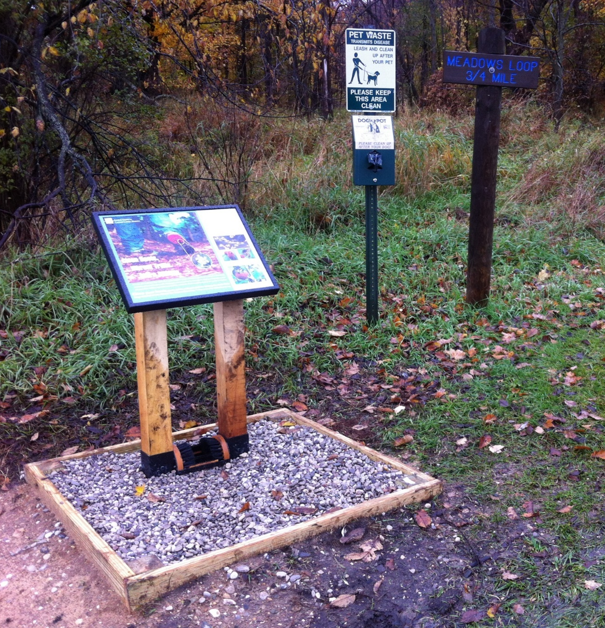
Bootbrush Stations
Sign, station, brush, lumber, $100 cost-share ($300 value)
Only a handful left!
Space on sign for logo sticker
Need gravel, concrete, screws & installation/assembly
Upgrade or mini-station: scrub brush, cable, & keeper ($20)
Play Clean Go has smaller signs

Slide 18
“Field” Season 2020
Really didn’t get started until August but…
Still treated over 250 sites
Treated 170 acres
37 new sites
Already have 9 new sites for treatment next year (and still sending more permissions!)
Treated two new species this year “giant Chinese silvergrass, Miscanthus “giganteus) and Chinese yam (population discovered 2019)
Looking to maybe do some more woody invasives treatments the next couple of months
Since we didn’t have a crew, here’s this picture of Fields hiding in the bittersweet.

Slide 19
HWA Update
We’re getting money for this!
That’s about all we know for sure right now.
Current ideas:
HWA landowner survey request is still open
Hopefully hiring on a seasonal for part time (30 hour/week)
Possibly helping Mason county do some detection surveys
Training landowners of small properties to watch their own trees and report data to us (or Eyes on the Forest)
Holding a webinar for private landowners to survey their trees.
(Fields hides in bittersweet, but I hide in hemlocks!)

Slide 20
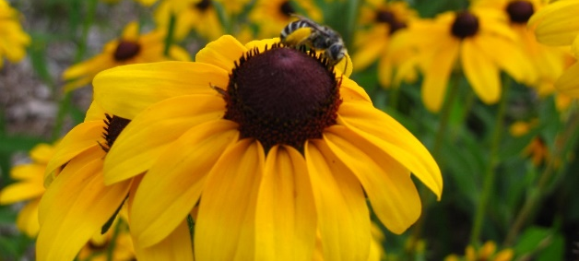
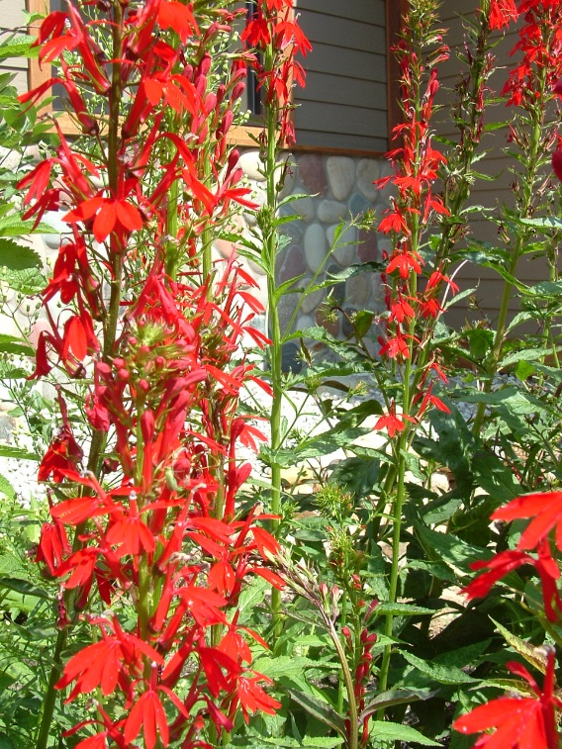
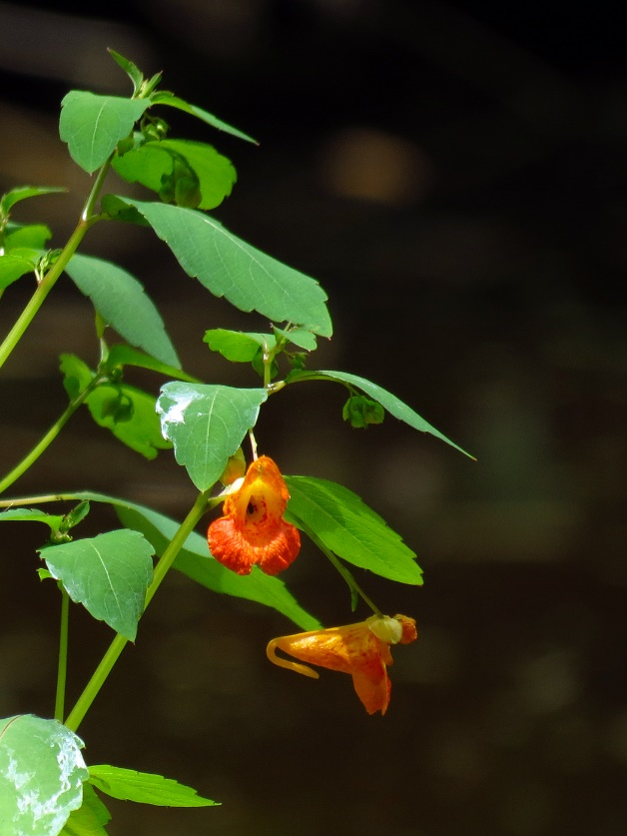
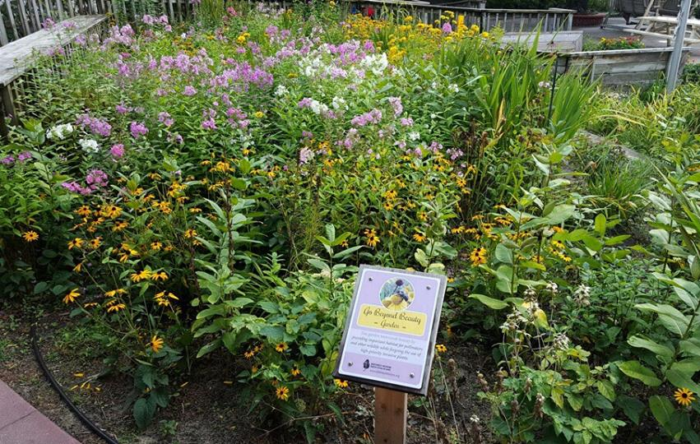
UPDATES…
COVID-19
Go Beyond Beauty Specialist started April September
Unexpected potential benefit - people spending more time at home/in their yards?
Advisory Committee created
Help guide statewide initiative
CISMAs, garden professionals & Stewardship Network

Slide 21
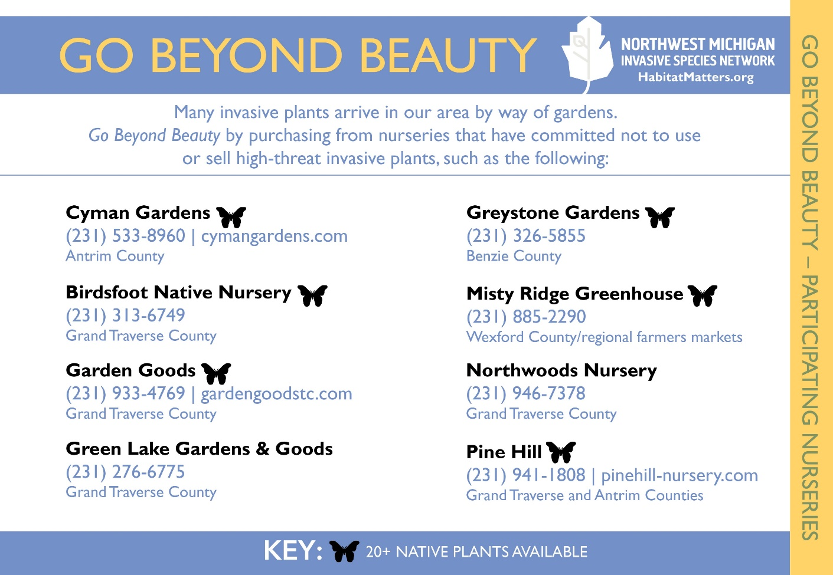
THE 2019 CLUB…

Slide 22
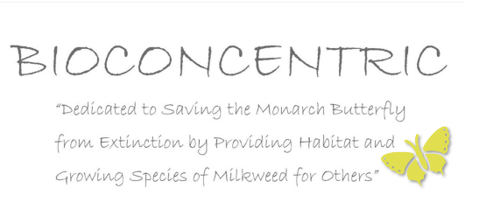
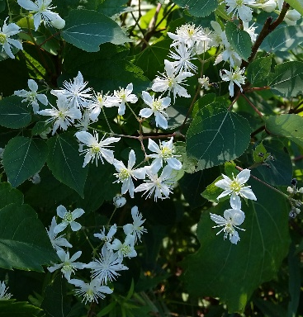
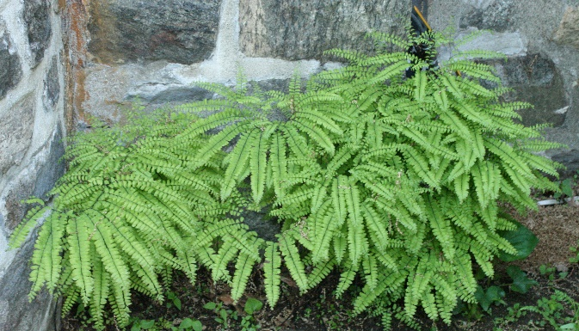
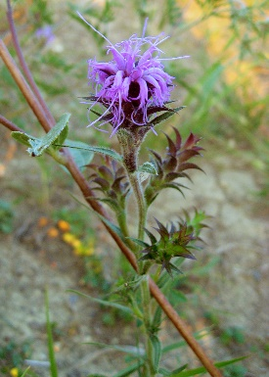
IS JOINED BY…
11 New Participants in 2020
2 Nurseries
Both sell 20+ native species
3 Landscaper/Garden Professionals
6 Community Participants
1 Organization
2 Gold Level Participants
54 Participants Total

Slide 23
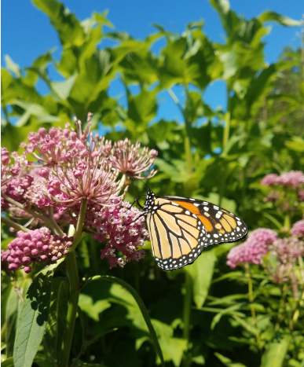
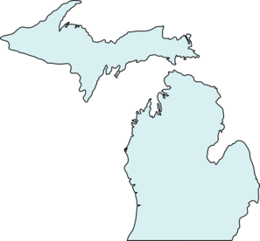
FUTURE PLANS…
Statewide Initiative – Helping Michigan Go Beyond Beauty
Goals
Expand existing program
Establish regional hubs
What it will look like
Year 1: Strengthen program at home
Building relationships
Approach potential hubs
Prepare for statewide expansion
Years 2 & 3: Statewide rollout
Establish & empower regional hubs
Statewide meetings
GBB Spring Meeting TBD

Slide 24
BREAK!
5 minutes
Small group activity next!

Slide 25
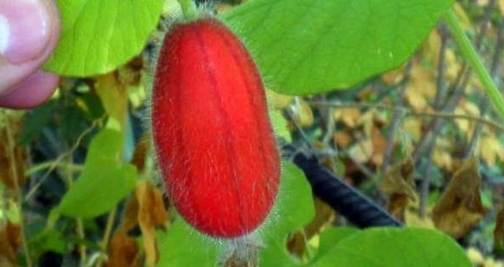
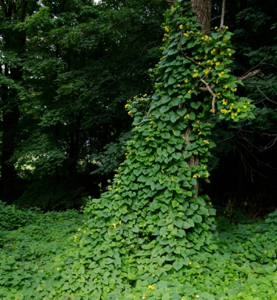
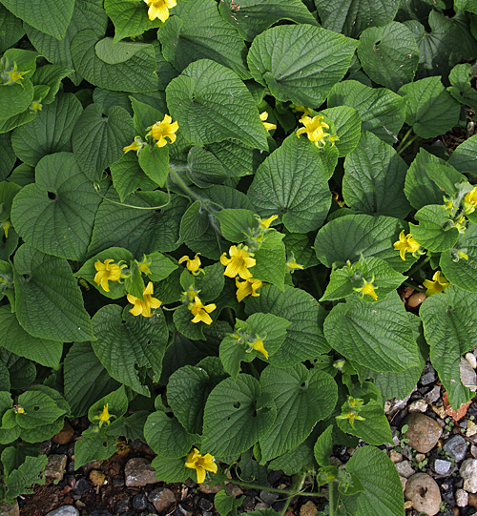
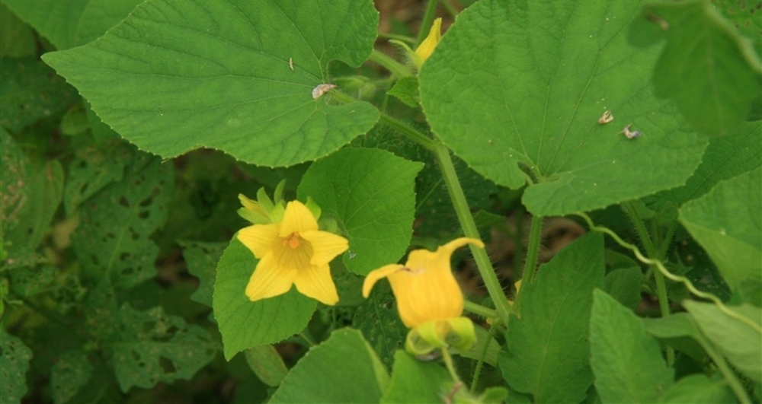
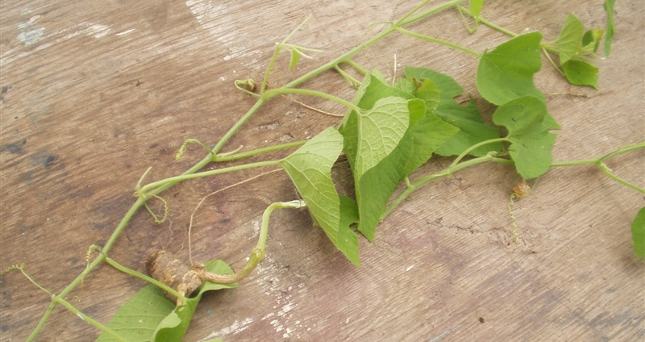
Goldencreeper (Thladiantha dubia)
Notes:
AKA Manchu tubergourd; found in Washtenaw Co (Matthaei)

Slide 26
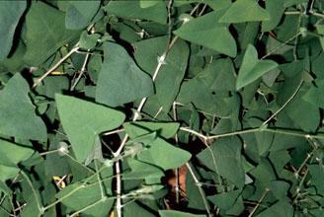
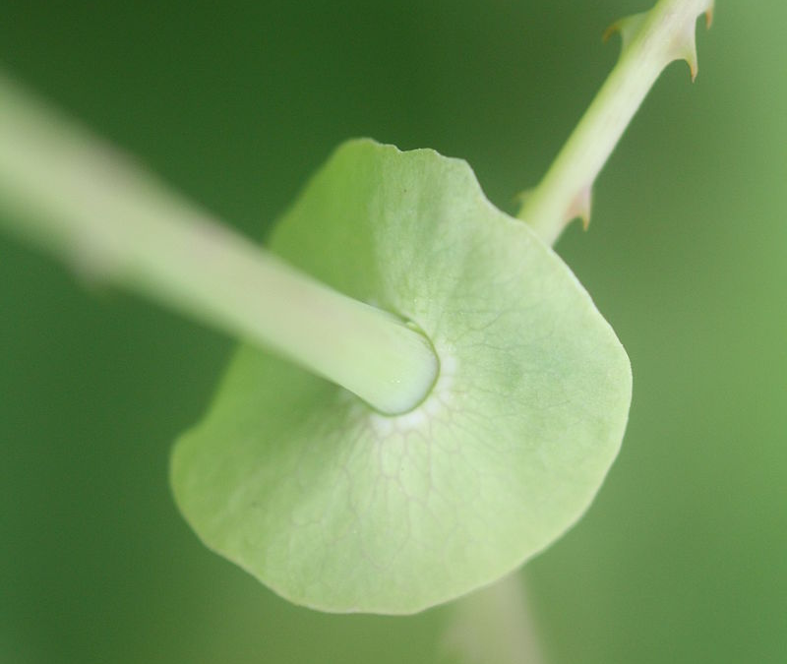
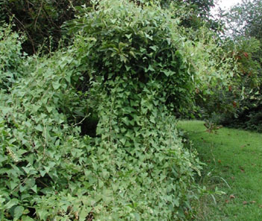
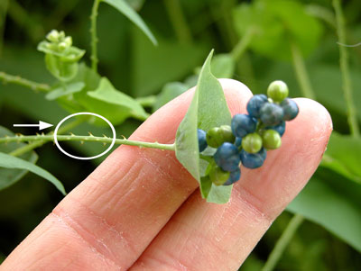
Mile-a-minute weed (Persicaria perfoliata)
Notes:
AKA devil’s tearthumb, sometimes Polyganum

Slide 27
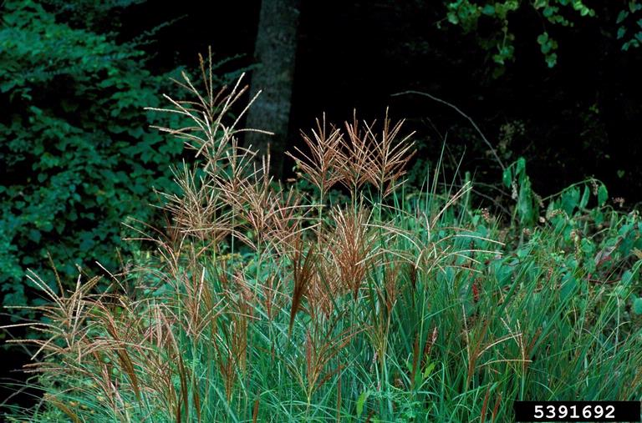
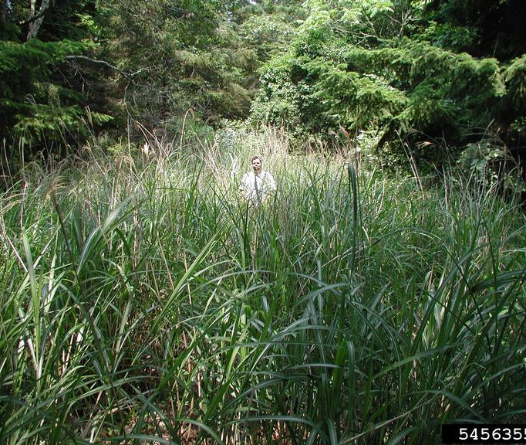
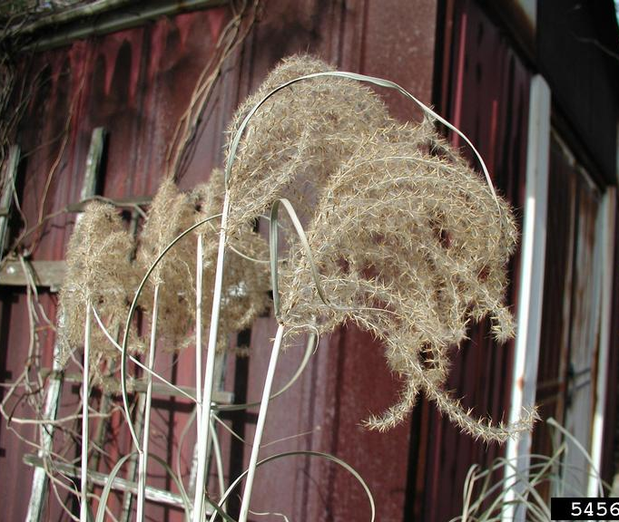
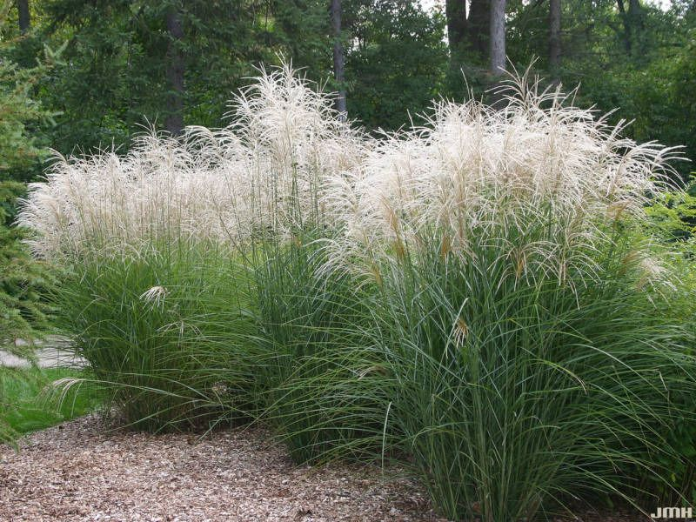
Chinese silvergrass (Miscanthus sinensis)

Slide 28
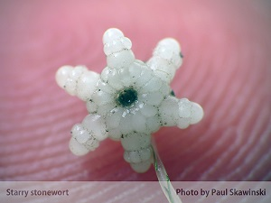
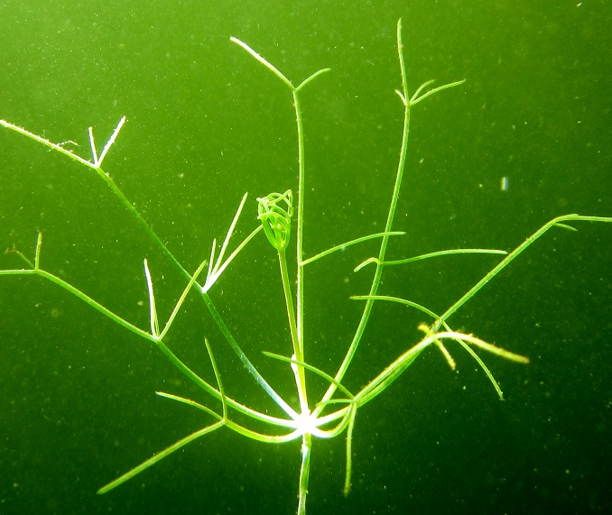
Starry Stonewort (Nitellopsis obtusa)

Slide 29
MISIN www.MISIN.msu.edu
Data submission
Web
App (Apple/Android)
Identification resources
1pg (species information)
Training modules (Tools>>Training modules)
Treatment Tracking

Slide 30
Resources Reminder
HabitatMatters.org/other-information
Decontamination Protocols
Planting Guides (municipalities)
Print & Online resource lists
MISC Forum (forum.michiganinvasives.org/)

Slide 31
BREAK!
Thistle the Corgi
Finn the Collie
Persephone the Cat
Tiberius the Cockatiel
Holly the Collie
Eamon the Retriever
5 minutes
Sampson the Cat

Slide 32
Grants Update Current Grants
Fully funded through 2021+
Strongly funded to 2023
MISGP 2018 Project
2021 Crew
Treatments, outreach, “leadership in IS work”
MISGP 2019 CISMA
Basic functions, outreach
MISGP 2019 GBB
Strengthen current program
Bring GBB state-wide!
USFS CWMA 2019
Treatment, outreach, staff time
USFS CWMA 2020
Staff time, treatment, restoration
Good Neighbor Authority
Treatments/staff time
Notes:
NEEDS UPDATE

Slide 33
Upcoming Grants
USFS CWMA 2021
MISGP 2020
HWA subgrant extension
Survey team
Extended dumpsters
Additional species work
Prevention & prioritization
Stephanie Heit
Ted Kraimer
Notes:
UPDATE

Slide 34
State-wide & Regional Updates
Michigan Invasive Species Coalition
Play, Clean, Go
MIPN & WIGL Collaborative
Local CISMAs

Slide 35
Partner Updates!
2 minutes each, please

Slide 36
Protecting, enhancing, and promoting Northwest Michigan's natural communities through terrestrial invasive plant management and outreach.
Thank you for coming!

